Slide 1
Heat Illness Prevention Training
Division of Occupational Safety and Health (Cal/OSHA)

Slide 2
Training Goals
Review the regulatory language of Title 8 California Code of Regulations section 3395: Heat Illness Prevention in Outdoor Places of Employment
Review heat illness preventive measures
Increase awareness and commitment to safety and health at all work sites

Slide 3
Heat Illness Prevention Elements Include:
Access to Water
Access to Shade
Weather Monitoring and Acclimatization High Heat Procedures
Employee and Supervisory Training
Written Procedures Including Emergency Response

Slide 4
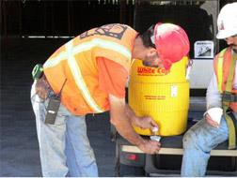
Access to Water (1 of 4)
Potable drinking water must be made available at no cost to all employees
Maintain, at all times, sufficient quantities of pure and cool potable drinking water (i.e. enough to provide at least one quart per employee per hour for the entire shift)

Slide 5
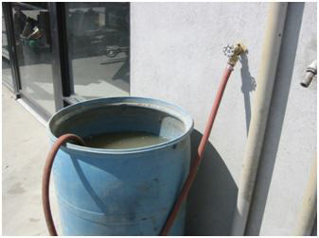
Access to Water (2 of 4)
Water must be fit to drink. Water containers CAN NOT be refilled from non-potable water sources (e.g. irrigation wells, sprinkler or firefighting systems)
Care must be taken to prevent contamination of the drinking water supplied to employees

Slide 6
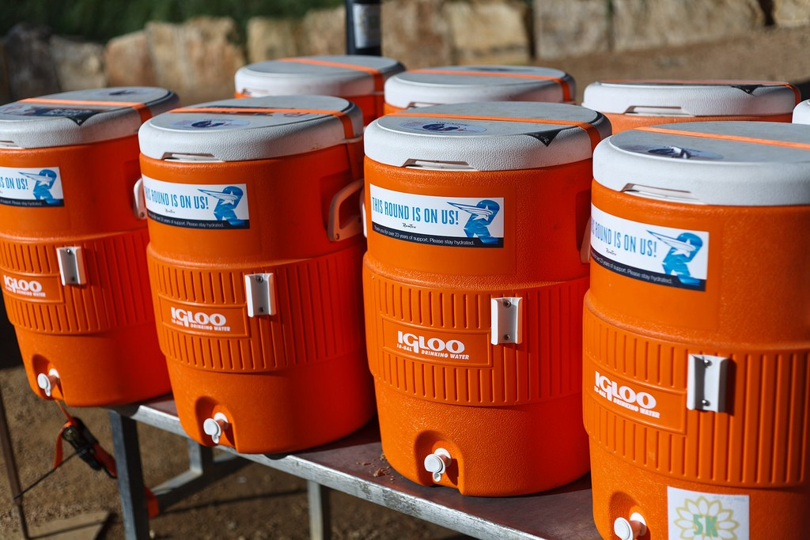
Access to Water (3 of 4)
Implement and maintain effective replenishment procedures when beginning the shift with smaller quantities

Slide 7
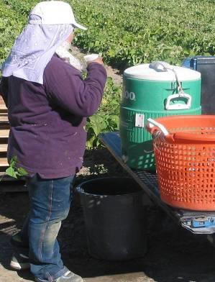
Access to Water (4 of 4)
Locate the water containers as close as practicable given the working conditions and layout of the worksite
Keep it readily accessible, move it with the employees
Encourage the frequent drinking of water
Remind employees to not wait to hydrate until they are thirsty

Slide 8
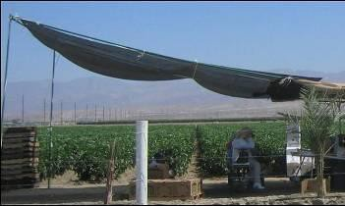
Shade Up:
When the temperature exceeds 80° F (1 of 2)
Have and maintain one or more areas of shade at all times, when employees are present
Locate the shade as close as practical to the area where employees are working

Slide 9
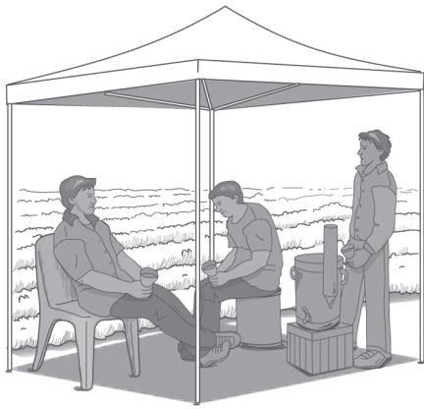
Shade Up:
When the temperature exceeds 80° F (2 of 2)
Provide enough shade to accommodate the number of employees on recovery or rest periods
Provide enough shade to accommodate the number of employees on meal periods who remain on site
Remember: Access to shade must be permitted at all times

Slide 10
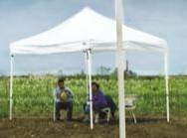
Shade available:
When the temperature is below 80°F
When the temperature does not exceed 80°F, shade shall either be up or provided timely upon request

Slide 11
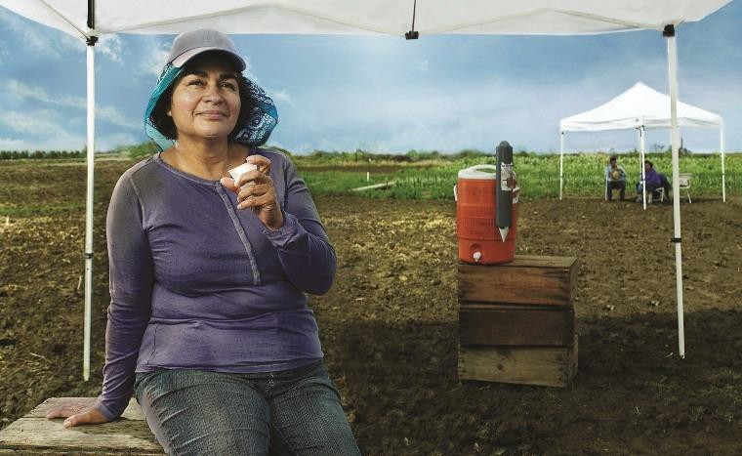
Access to Shade (1 of 2)
Encourage employees to take a
cool-down rest in the shade
Monitor employees on cool-down rests
Ask them if they’re experiencing symptoms of heat illness
Allow at least a 5-minute rest and don’t order back to work until symptoms have abated
Take appropriate first aid steps or emergency response as necessary

Slide 12
Access to Shade (2 of 2)
Shaded areas must not cause exposure to another health or safety hazard. Areas underneath mobile equipment (e.g. tractors), or areas that require crouching in order to sit fully in the shade are not acceptable.

Slide 13
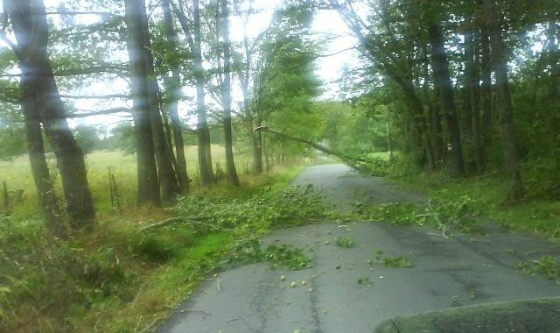
When Infeasible or Unsafe
In situations where the employer can demonstrate that it is not safe or feasible to provide shade, an employer can utilize established procedures for providing shade upon request or, for non-agricultural employers, alternative cooling measures that provide equivalent protection.

Slide 14
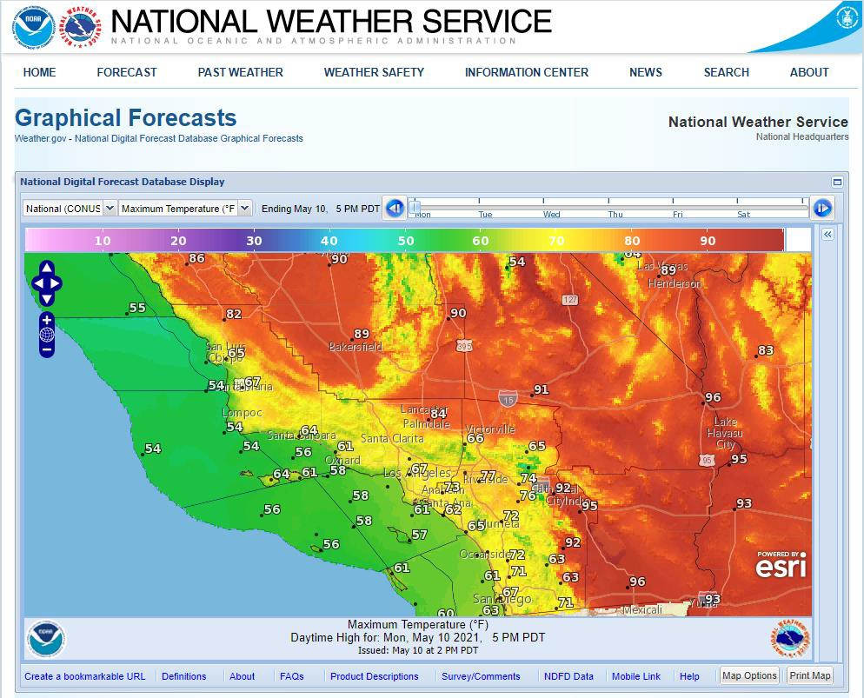
Monitor the Weather www.nws.noaa.gov
Instruct supervisors to track the weather of the job site [by monitoring predicted temperature highs and periodically using a thermometer]
Determine, and instruct supervisors, on how weather information will be used to modify work schedule, increase number of water and rest breaks or cease work early if necessary

Slide 15
High Heat Procedures
Industries covered by this subsection:
Agriculture
Construction
Landscaping
Oil and Gas Extraction
Transportation or delivery of agricultural, construction materials or other heavy materials

Slide 16
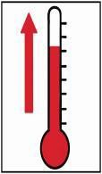
When the temperature equals or exceeds 95°F
(1 of 4)
You must implement additional preventive measures:
Ensure effective communication (by voice, observation or electronic means)

Slide 17
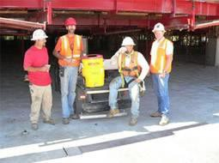
When the temperature equals or exceeds 95°F
(2 of 4)
You must implement additional preventive measures:
Observe employees for alertness and signs and symptoms of heat illness
Supervisory or designee observation of 20 or fewer employees
Mandatory buddy system
Regular communication
Other effective means

Slide 18
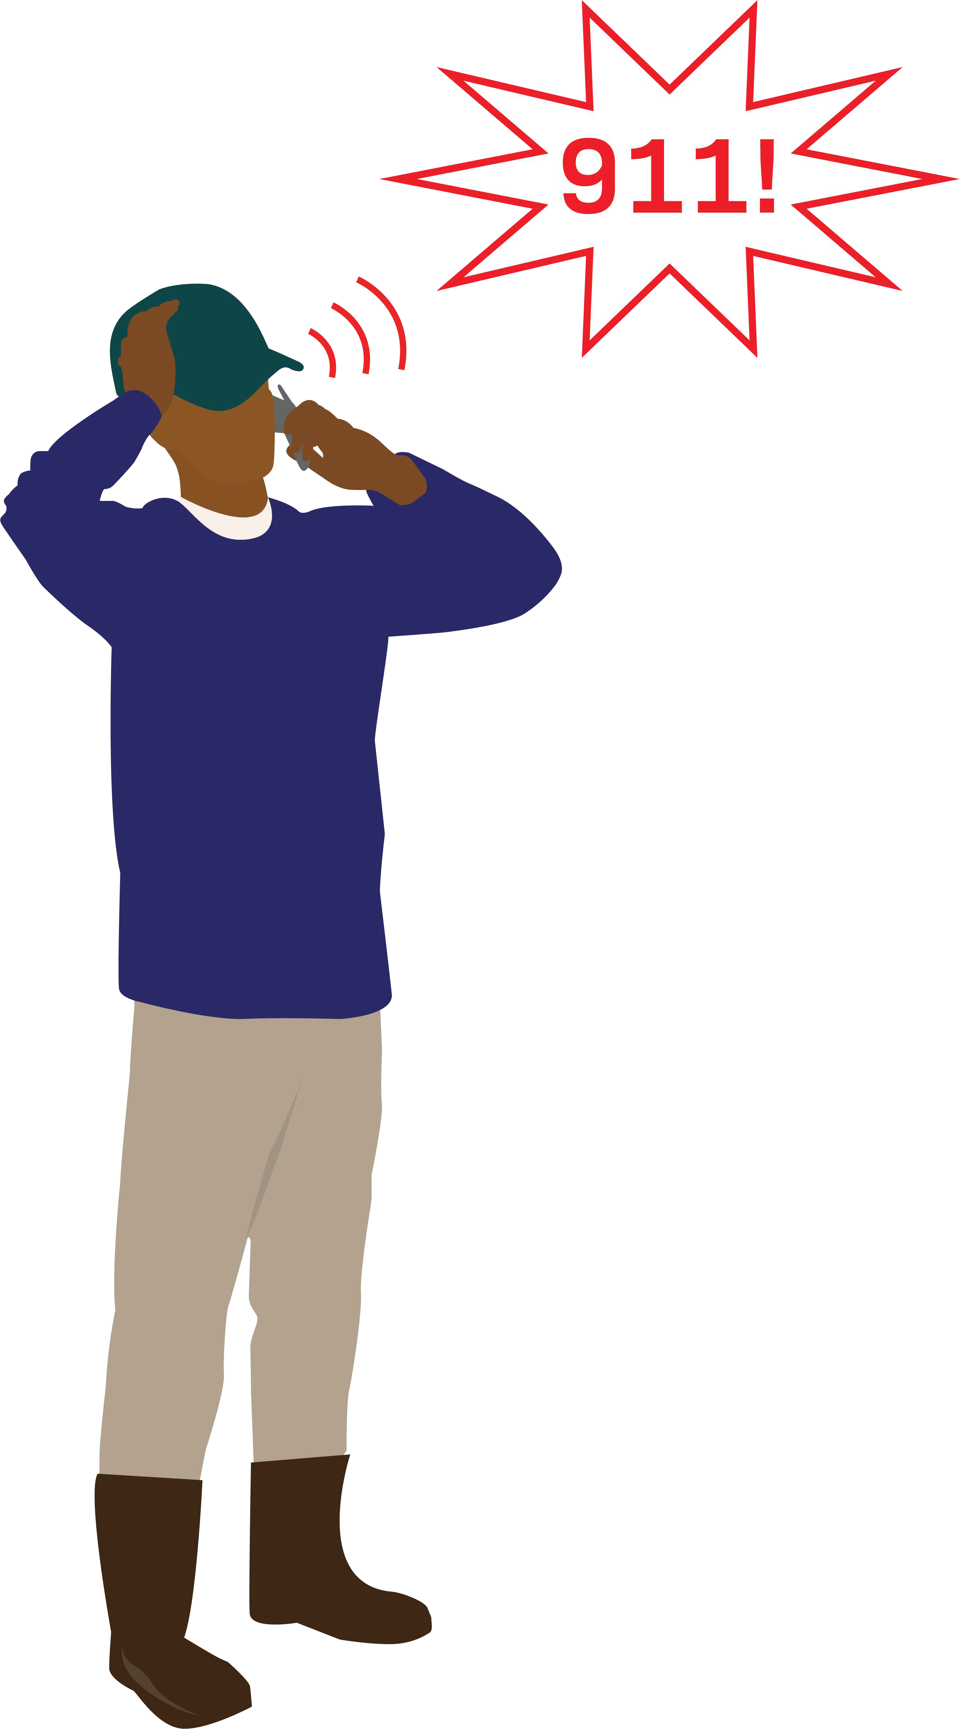
When the temperature equals or exceeds 95°F
(3 of 4)
Designate one or more employees to call for emergency services
Give more frequent reminders to drink plenty of water
Hold pre-shift meetings on prevention

Slide 19
When the temperature equals or exceeds 95°F
(4 of 4)
For agricultural employers:
Temps 95 or above, ensure employees take a minimum ten-minute net preventative cool-down rest every two hours.
Additional ten-minute cool-down rest at end of 8th and 10th hour of work.

Slide 20
Emergency Response Procedures
Ensure effective communication
Respond to signs and symptoms of possible heat illness:
Supervisor to take immediate, appropriate action
If indicators of serious heat illness, implement emergency response procedures
Employees exhibiting or reporting signs or symptoms of heat illness shall be monitored and not left alone. Onsite first aid or appropriate emergency medical services shall be offered
Contact emergency medical services and ensure that clear and precise directions to the site can be provided

Slide 21
Address Lack of Acclimatization (1 of 2)
As an employer, you are responsible for the working conditions of your employees, so you must act effectively when conditions result in sudden exposure to heat that your employees are not used to.
All employees shall be closely observed by a supervisor or designee during heat waves.
Employees newly assigned to high heat areas shall be closely observed by a supervisor or designee for the first 14 days of employment.

Slide 22
Address Lack of Acclimatization (2 of 2)
Thus, determine how your company will:
Be extra vigilant with your employees to recognize immediately symptoms of possible heat illness
Lessen the intensity and/or shift length of the newly-hired employees’ work during a two or more week break-in period
Modify the work schedule or reschedule nonessential duties during the hot summer months

Slide 23
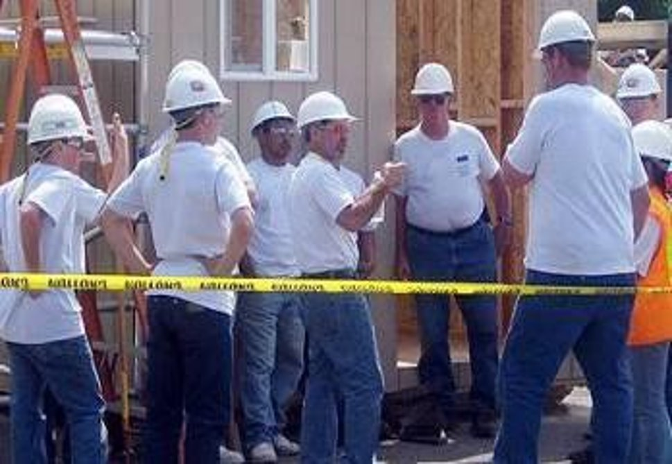
Employee & Supervisor Training
Ensure all employees and supervisors are trained before beginning work that should reasonably be anticipated to result in a heat illness.

Slide 24
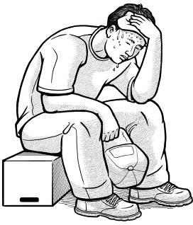
Employee Training (1 of 5)
Training should be given on:
The environmental and personal risk factors for heat illness, as well as the added burden of heat load on the body

Slide 25
Environmental Risk Factors for Heat Illness
Means working conditions that create the possibility that heat illness could occur, including:
Air temperature
Relative humidity
Radiant heat from the sun and other sources
Conductive heat sources such as the ground
Air movement
Workload severity and duration
Protective clothing and personal protective equipment worn by employees

Slide 26
Personal Risk Factors for Heat Illness
Means factors that affect the body's water retention or other physiological responses to heat, including:
An individual's age
Degree of acclimatization
Health
Water consumption
Alcohol and caffeine consumption
Use of prescription medications (such as antihistamines for allergies, diuretics (water pills) and some psychiatric or blood pressure medicines
Use of illicit drugs (such as opioids, methamphetamines or cocaine)

Slide 27
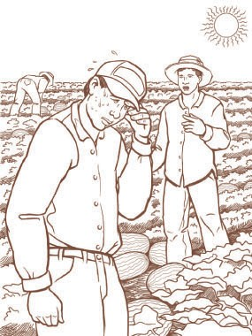
Employee Training (2 of 5)
Training should be given on:
The company’s heat illness prevention procedures, including but not limited to:
The employer’s responsibility to provide water, shade, cool-down rests, and access to first aid as well
Employees’ ability to exercise their rights under this standard without retaliation

Slide 28
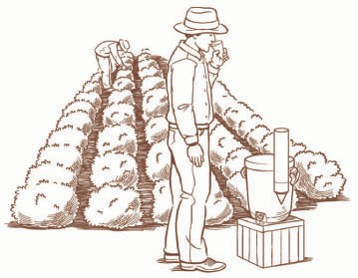
Employee Training (3 of 5)
Importance of frequent consumption of small quantities of water
Different types of heat illness, common signs and symptoms; and appropriate first aid or emergency response
Knowledge that heat illness may progress rapidly

Slide 29
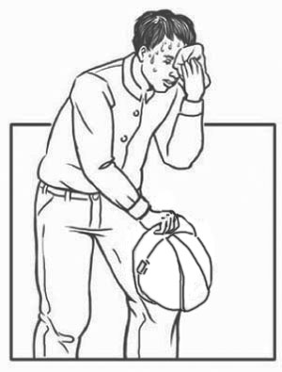
Employee Training (4 of 5)
The concept, importance, and methods of acclimatization
Training must include the importance of acclimatization, how it is developed, and how the company’s procedures address it
Importance of immediately reporting signs or symptoms of heat illness to a supervisor
Procedures for responding to possible heat illness

Slide 30
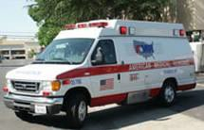
Employee Training (5 of 5)
Procedures to follow when contacting emergency medical services, providing first aid, and if necessary transporting employees
Procedures that ensure clear and precise directions to the work site, including designating a person to be available to ensure that emergency procedures are invoked when appropriate

Slide 31
Supervisor Training
Supervisors must be trained on:
Heat standard requirements
Procedures they must follow to implement the requirements
Procedures to follow when a employee exhibits or reports symptoms consistent with possible heat illness, including emergency response procedures and first aid
How to monitor weather reports and how to respond to hot weather advisories

Slide 32
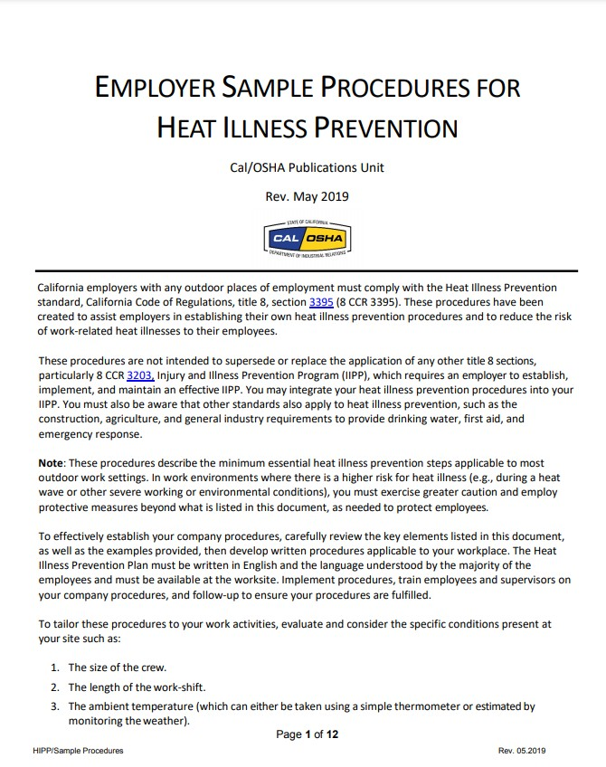
Written Plan (1 of 2)
As long as the procedures are effective, the company’s Heat Illness Prevention Plan can be integrated into the IIPP
Maintain the Plan on site or close to the site, so that it can be made available to employees and representatives of Cal/OSHA upon request
The written Plan should be in English and the language understood by the majority of employees

Slide 33
Written Plan (2 of 2)
Detail how the company will:
Provide access to water & shade
Monitor the weather
Institute high heat procedures
Address acclimatization methods and procedures
Train all employees and supervisors
Respond to heat illnesses without delay, provide first aid and emergency services
Provide clear and precise directions to the worksite

Slide 34
Serious Hazard
The company risks a serious citation if the outdoor temperature in the work area exceeds 80°F and any of these required elements is not present at the site:
Drinking water
Shade
Trained employees or supervisor
Emergency response procedures

Slide 35
Imminent Hazard – Don't Risk an OPU!
The company may risk an Order Prohibiting Use (OPU) and a Serious Citation if the heat and lack of facilities create an imminent hazard.
An OPU may be issued if:
The temperature is ≥ 95° and water, shade, training or emergency procedures are not in place
The temperature is ≥ 80°, and there is a heat wave, heavy workload or other critical factor putting employees in danger
An OPU:
Will shut down the operation
Work will not be allowed to resume until the employer demonstrates that the imminent hazard has been corrected

Slide 36
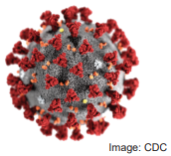
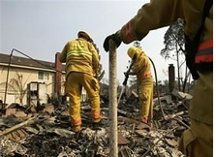
Additional Considerations
COVID-19 Emergency Temporary Standards
Review the latest updates to the COVID-19 Prevention Emergency Temporary Standards at Cal/OSHA’s coronavirus webpage: https://www.dir.ca.gov/dosh/coronavirus/
Protection from Wildfire Smoke
Review Cal/OSHA’s webpage on Worker Safety and Health in Wildfire Regions: https://www.dir.ca.gov/dosh/worker-health-and-safety-in-wildfire-regions.html

Slide 37
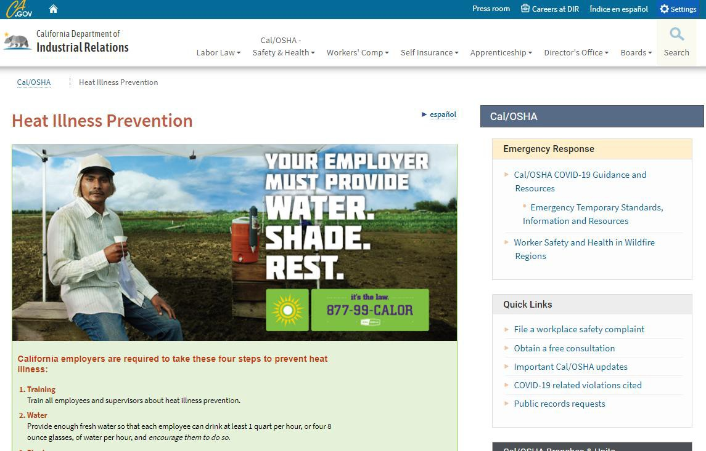
For Additional Information
Visit the Cal/OSHA Heat Illness Webpage:
http://www.dir.ca.gov/DOSH/HeatIllnessInfo.html
Contact us by email: heat@dir.ca.gov

Slide 38
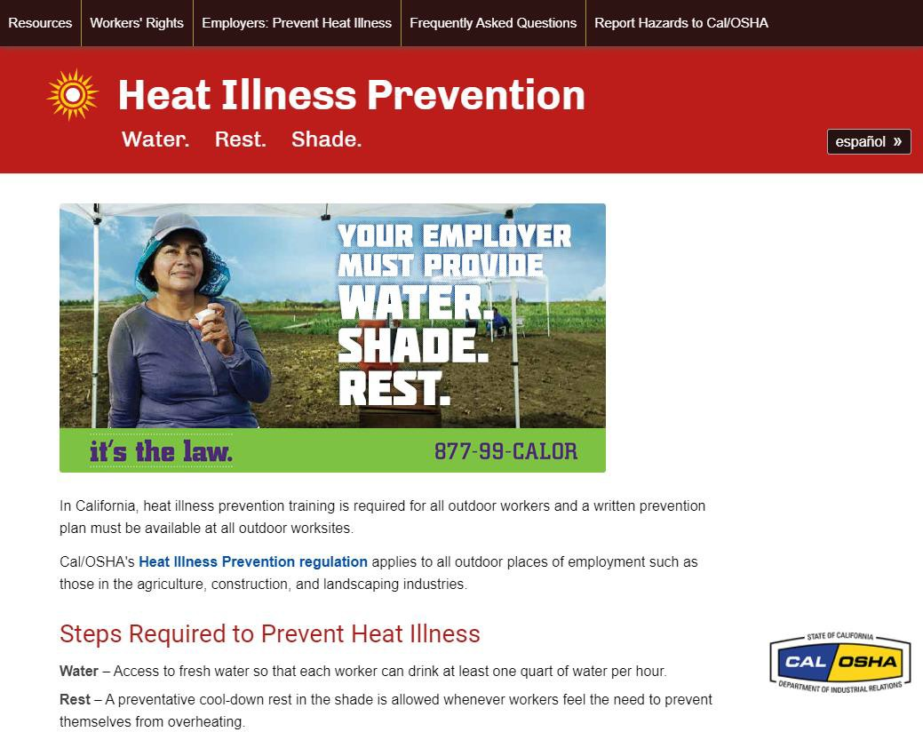
Heat Illness Materials
Multilingual educational materials can be downloaded
free from the www.99calor.org website

Slide 39
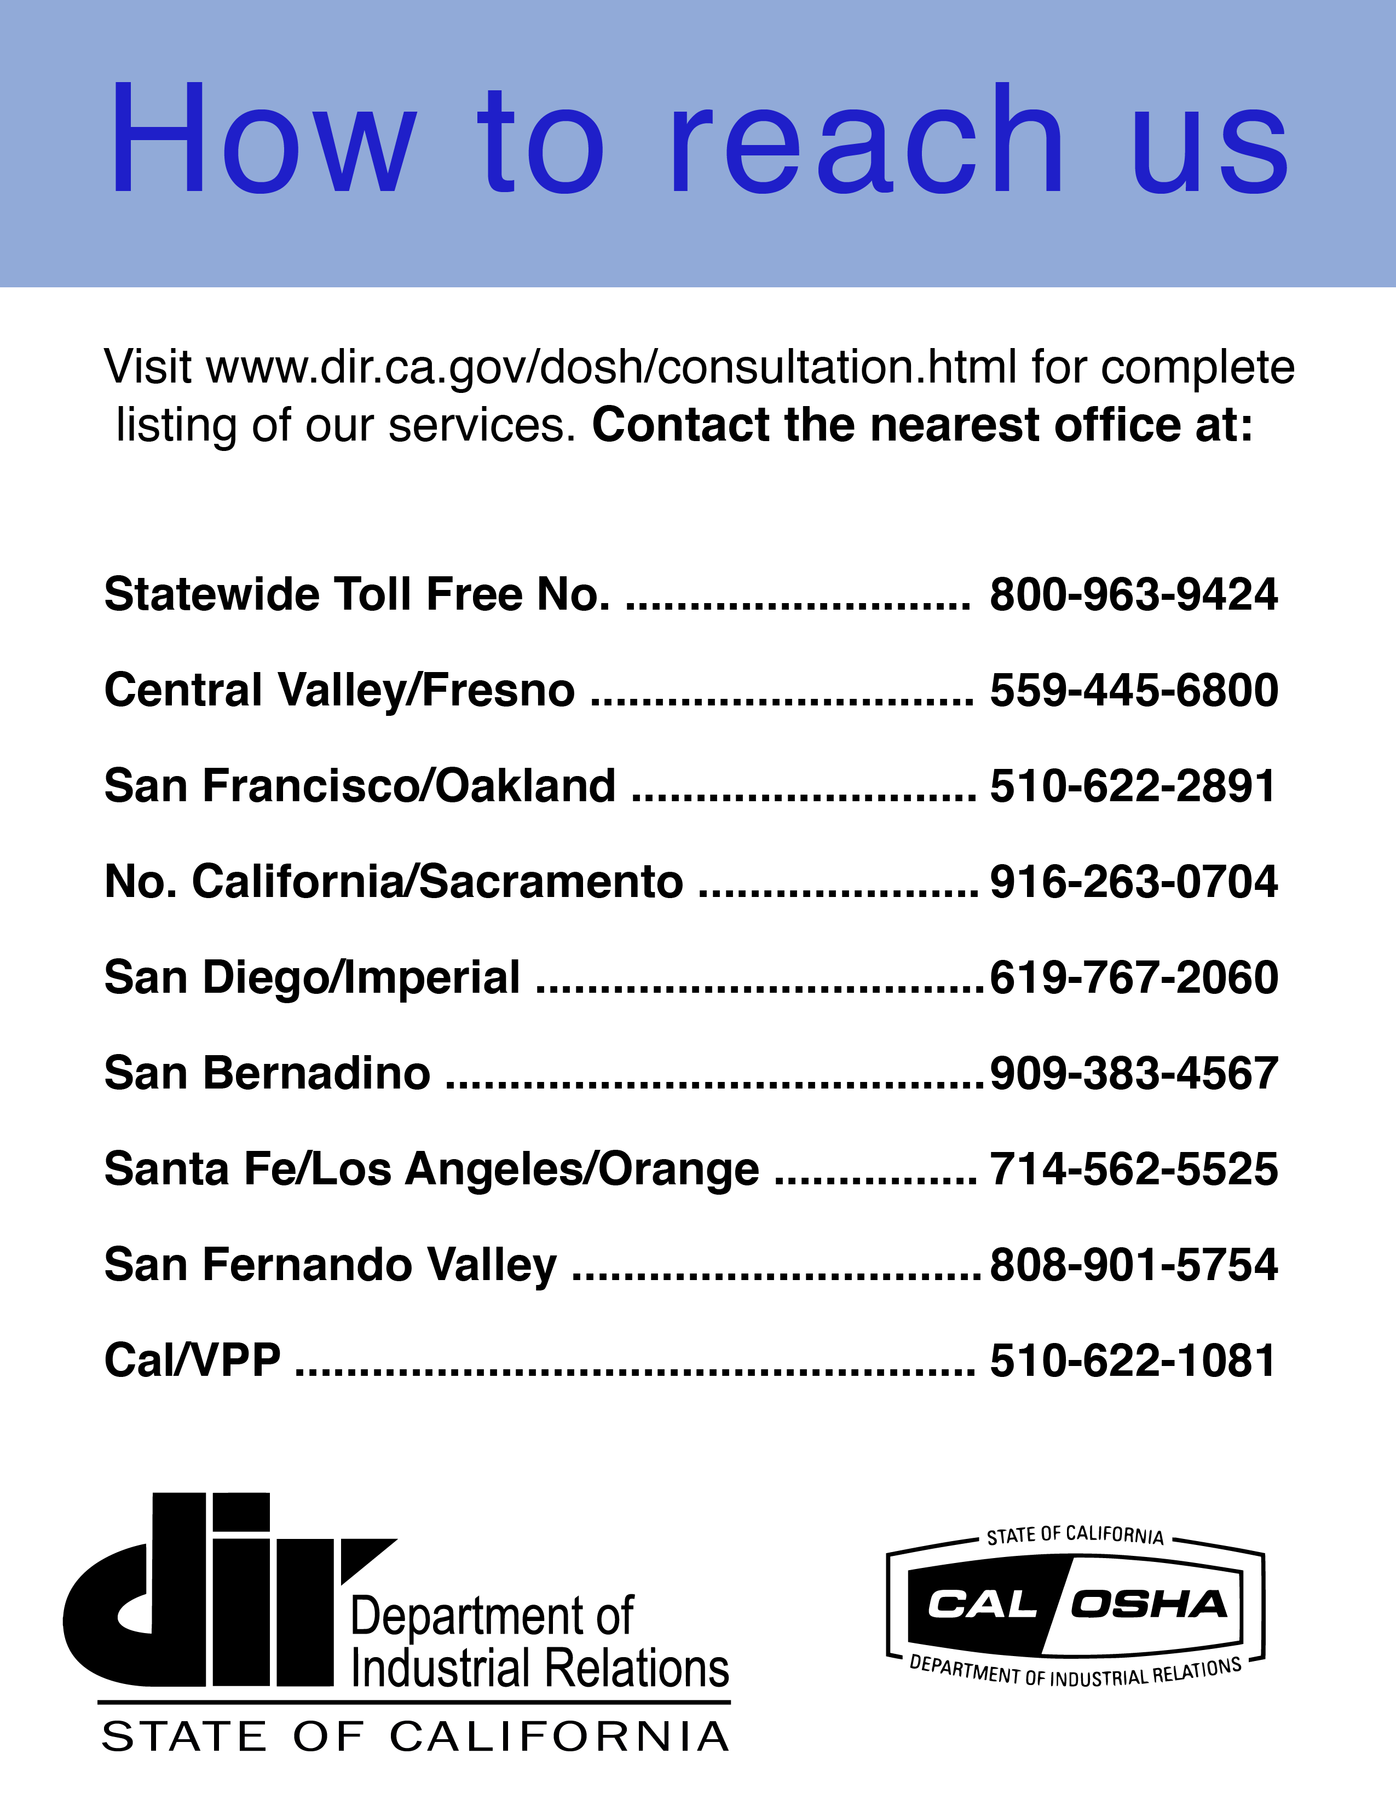
Cal/OSHA Consultation Services

