Slide 1
Educational Report
Gary Adams, Dean of Apprenticeship and Adult Education
Dr. Sabrina Lopez, Apprenticeship Program Lead
Dalbir Singh, Community College Program Assistant II

Slide 2
Reporting Updates
Projection Due 10/1/24
  9 reports were submitted past the submission deadline or are still outstanding
P1 Due 1/15/25
  7 reports were submitted past the submission deadline or are still outstanding
P2 Due 5/15/25
  11 reports were submitted past the submission deadline or are still outstanding
Projection Due 10/1/25
Recalculation Due 11/1/25

Slide 3
Fiscal Year 2024-25 RSI Outcomes
RSI
FTES
Hours of Instruction Funded Until P2: 7,094,109
Number of Apprentices Instructed Until P2: 107,693
Hours of Instruction Funded Until P2: 42,724
Number of Apprentices Instructed Until P2: 2,098

Slide 4
Fiscal Year 2025-26 Allocations
Schedule 2 (CCDs)
  $35,622,000
Schedule 3 (K-12 LEAs)
  $62,485,000
One-Time Shortfall for FY 2022-23 and 2023-24
  $6,333,000
Updated Hourly Rate
  $10.32
California Apprenticeship Initiative
  $30m
  Upcoming Funding Opportunity TBD
*Information is based on AB-102 Budget Act of 2025

Slide 5
Technical Assistance Providers
Foundation for California Community Colleges
LAUNCH Apprenticeship Network
Guidance Documents and Toolkits
Virtual Office Hours
Vision Resource Center
Statewide Training Opportunities
apprenticeshipsupportnetwork@foundationccc.org
Statewide and Regional Support
  Apprenticeship and Pre-Apprenticeship
  Contract Education
  Credit for Prior Learning
Employer Engagement Infrastructure
Sponsorship Support

Slide 6

Chancellor’s Office Support
Virtual Office Hours​
  2nd and 4th Tuesday of the month from 2:00PM-3:00PM​
  https://cccco.zoom.us/j/83752577222?pwd=W2DLzPlSbAxWfQGan7vPgWZ1SsJQ0x.1
apprenticeship@cccco.edu ​
Stay informed! Join the WEDD email list at https://LISTSERV.CCCNEXT.NET/scripts/wa-CCCNEXT.exe?SUBED1=WEDD_ALL

Slide 7
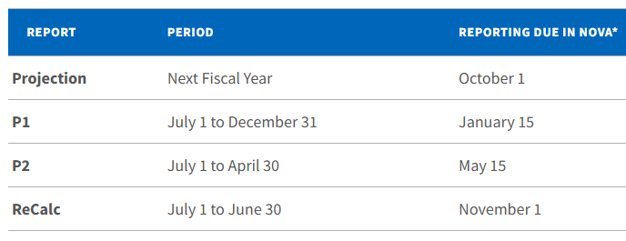
Request for Feedback
Ongoing Challenge
Proposed Solution
The CCCCO has seen an approximate $6m deficit each FY, primarily impacting Schedule 3 funding.
There has also been an increased request for Schedule 2 funding.
Current RSI Reporting Deadlines
Proposed RSI Reporting Deadline Change
  Projection – July 1st
  ReCalc - July 15th

Slide 8
Thank you!

