Slide 1
Introduction to EAMS & eForms

Slide 2
Website Links
Main EAMS website
Uniform Assigned Name (UAN) Online Database
  Locate the header with the hyperlinks to search the Database.
Public Case Information Search
  Information
  Search
Working in EAMS webpage where you will find the links to the UAN and the EAMS Case Number Lookup Tool as well as other helpful guides and links.

Slide 3
Recommended Settings
Internet Explorer (IE) is no longer supported by Microsoft, so it is recommended that you utilize IE mode in the Microsoft Edge Browser when e-filing. Other browsers may allow viewing access, but not necessarily e-filing.
You can find related recommended setting information in the Accessing EAMS in Microsoft Edge Internet Explorer Mode PDF under the Resources heading on the E-form filers page on the DWC website.

Slide 4
Frequently Used Terms and Abbreviations
Adjudication Case (court case) = ADJ
Date of Birth = DOB
Date of Injury = DOI
Division of Workers’ Compensation = DWC
Electronic Adjudication Management System = EAMS
EAMS Reference Number = ERN
Injured Worker = IW
Social Security Number = SSN
Unprocessed document queue = UDQ
Uniform Assigned Name = UAN
Workers’ Compensation Judge = WCJ
Third Party Administrator = TPA
Third Party Filer = TPF

Slide 5
Multiple methods of submitting documents
eForms – Used to electronically e-file one document packet at a time.
OCR – Optical Character Reader used to file by paper at the district office that will have or does have the selected venue.
JET – Can be used to electronically bulk-file select documents. Requires specialized software to utilize.
The Working in EAMS webpage offers more information about these various filing methods.
Exceptions:
  Documents completed at a District Office or as otherwise specified, e.g. DOR for satellite District Office, or DOR for asbestos cases.
  If eForm filing is not successful for the regular DOR, please email the EAMS Help Desk (EAMSHELPDESK@dir.ca.gov) for assistance.

Slide 6
Civil Code Section §1798 Compliance 1 of 4
The Civil Code Section §1798, also known as the Information Practices Act of 1977, states that “The Legislature declares that the right to privacy is a personal and fundamental right protected by Section 1 of Article I of the Constitution of California and by the United States Constitution and that all individuals have a right of privacy in information pertaining to them.”
The complete text can be found on the California Legislative Information website.

Slide 7
Civil Code Section §1798 Compliance 2 of 4
The organization or individual e-filer, not DWC, is solely responsible for compliance with Civil Code §1798.
The Primary Administrator, on behalf of the organization and the office, is responsible for securing and safeguarding the login. Once DWC issues the login to the office through the Primary Administrator, all responsibility for safeguarding and securing the login rests with the organization and the office, through the Primary Administrator and Designated Owner, and not with DWC.

Slide 8
Civil Code Section §1798 Compliance 3 of 4
The Primary Administrator is responsible for ensuring that the organization and the office develop, implement, disseminate, and enforce policies and procedures to safeguard and secure the login and that any employee or independent contractor whom the Primary Administrator permits to use the login is properly trained and supervised to safeguard and secure the login. Maintain reasonable security procedures and practices.
Any actual or potential breach or compromise of the security of the login or of any information potentially accessible using the login, must be reported to DWC by the organization and the office, through the Primary Administrator, immediately upon discovery thereof.

Slide 9
Civil Code Section §1798 Compliance 4 of 4
DWC shall have no liability to the organization or Primary Administrator for any loss or damages occasioned by any breach of the security of the organization’s login or password or of any information potentially accessible using the login and password. The cost, expense, or damages as a result of any actual or potential breach or compromise of the security of the login or of any information potentially accessible using the login, shall be the responsibility of the organization and the office, through the Primary Administrator, not DWC.

Slide 10
Primary Administrator Responsibilities Summary
Enforce contract conditions
Security, procedures, training and supervision
Report and disclose actual or potential breach
First level support
Assist and participate with DWC
  Help desk
  UDQ Supervisor
  eForms
Requests from anyone other than the Primary Administrator or Designated Owner if applicable will be returned to the sender.

Slide 11
eForm Registration
Organization
  They are assigned a Uniform Assigned Name (UAN).
    “Quasi-UANs” are also assigned to injured workers, employers, and third-party filers that are not required to have a UAN.
Person
  Usually an Injured Worker (IW)
User
  Linked by username and password to allow access to cases they are a party to.

Slide 12
eForm Registration cont.
Primary Administrator
  First level of support in their office(s)
  Authorized to make changes to the eForms agreement
  Responsible for completion of all required training and review of the EAMS E-form Filing Reference Guide (Reference Guide)
  A Designated Owner should be provided as a backup, but only as a interim option until a new Primary Administrator is registered through an amended eForms agreement.

Slide 13
Logons
Username – Usernames are assigned by the eForms Unit and are usually your EAMS Reference Number (ERN) plus “ef”.
  Example:
    UAN = FUDEM LAW SANTA ROSA
    ERN = 13580232
    Username = 13580232ef
Password – Passwords are typically 15 characters long and are randomly assigned by our IT department.
When submitting eForms using your e-filing logon, only one person can be logged in at a time.

Slide 14
Web Case Information Access
This is the first place to search to prepare for your filing.
Search case information on all cases:
  Search by Case Number or Injured Worker in Public Search
  Public Case Information Search Website
  Results include:
    Case Participants with address (not injured worker)
    Body Parts
    Current WCJ, Venue (Case Location), Case Number
    Next Hearing Date
    Will show if there is Disability Evaluation Unit (DEU) Product and if the case is archived.
    Limited Case Events

Slide 15
Uniform Assigned Names
EAMS regulation section 10205.5 (b) states:
  “In order to ensure case parties and documents are accurately associated to the correct electronic adjudication file, uniform names for claims administrators' offices, representatives' offices, and lien claimants shall be used when filing documents in EAMS. The names will be assigned by the Division of Workers' Compensation.”
A UAN is a name and physical location combination, which is posted on the DWC website & updated daily.
  EAMS UAN Database website

Slide 16
Uniform Assigned Names cont.
Do not make up your own UAN.
Only use those found on the online database list.
You must use the assigned UAN for ALL case participants that require a UAN.
  LAW FIRMS
    Including non-attorneys ~ Lien claimant representatives
  CLAIMS ADMINISTRATORS’ OFFICES
  LIEN CLAIMANTS
The address must be entered exactly as it is listed in the database.
If you do not have a UAN for an entity that is required, get it before you file – do not leave it blank.
If you have a problem with an entity registering for a UAN, email CRU@dir.ca.gov.

Slide 17
Central Registration Unit (CRU)
CRU assists with UAN updates such as:
  New offices and changes to the office
  Preferred method of service from the WCAB
  Change in Handling Location
  Change of Claims Administrators
Remember, it is not just your UAN, but also the UAN for all other such entities on the eForm.
E-mail CRU@dir.ca.gov
Fax 1-888-822-9309

Slide 18
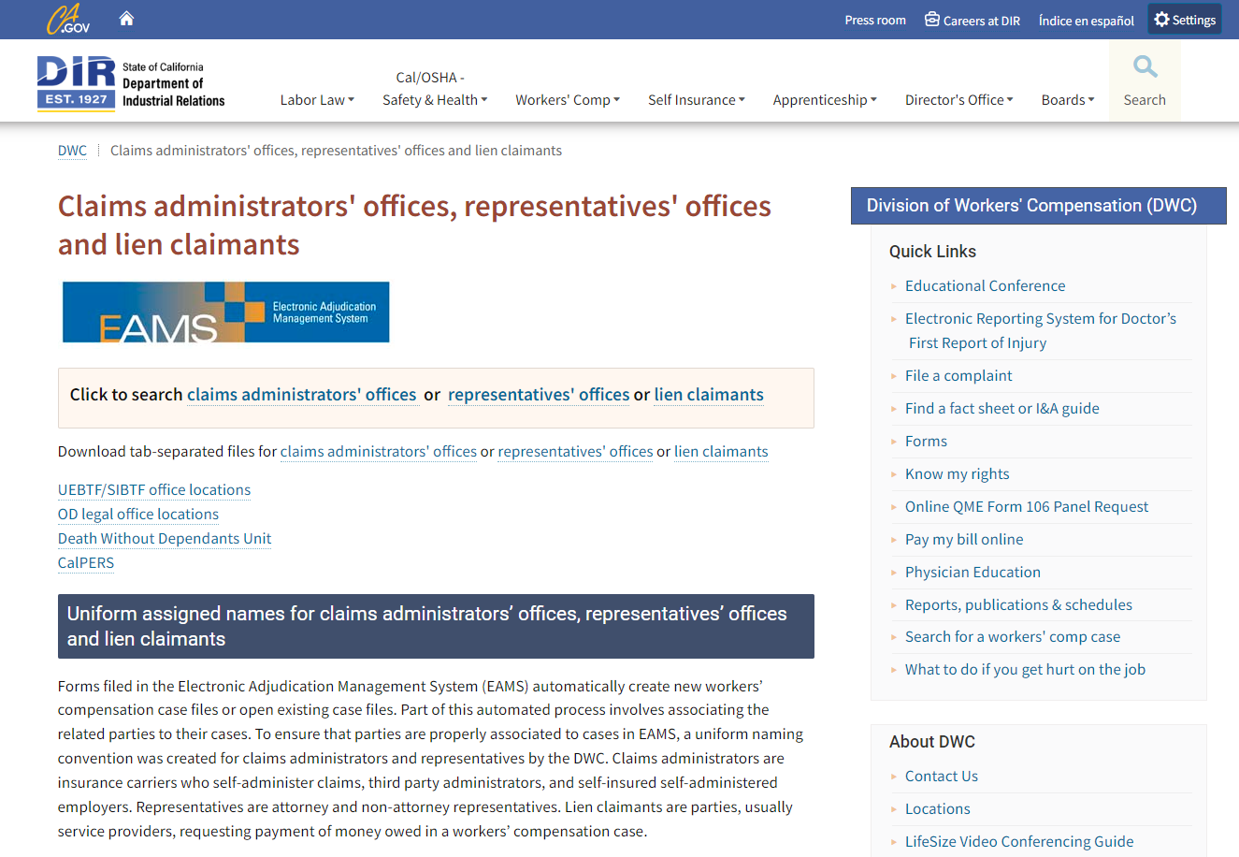
Searching for UANs
Visit the EAMS UAN Database webpage to find existing UANs.

Slide 19
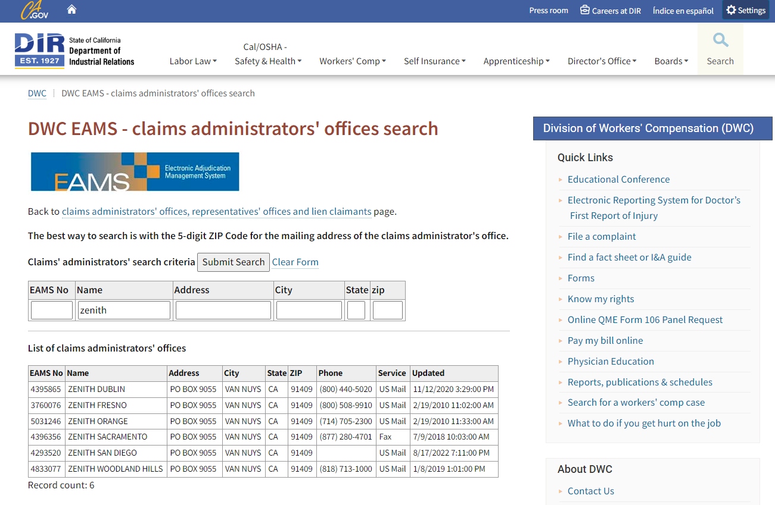
Searching for UANs cont.
Type in search criteria.
Review results.

Slide 20
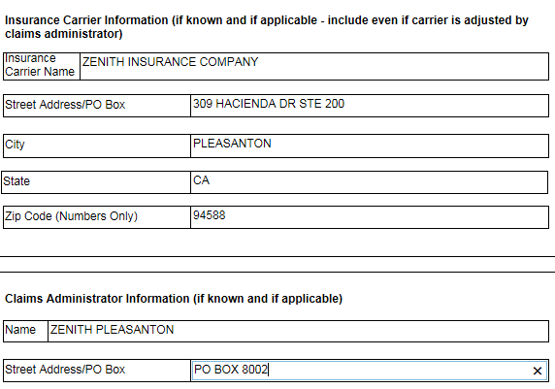
Where to use UANs
UAN not required here, unless there is no Claims Administrator.
UAN required here if there is a Claims Administrator.

Slide 21
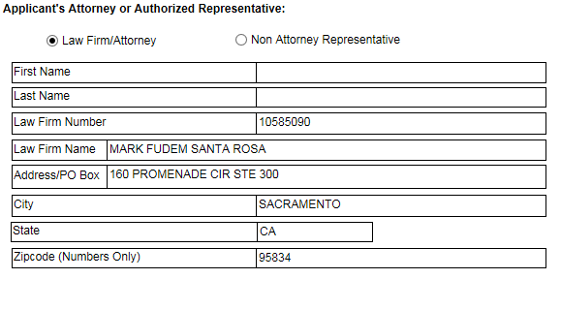
Where to use UANs – Applicant’s Attorney
UAN always required here

Slide 22
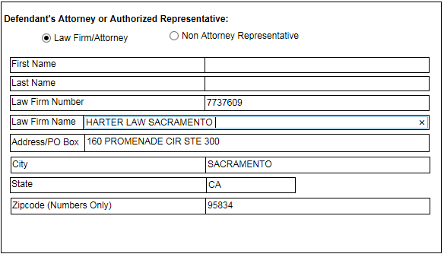
Where to use UANs – Defendant’s Attorney
UAN always required here, but watch out for extra spaces, because these are not allowed.

Slide 23
Logging into EAMS

Slide 24
The first time you login to EAMS
Verify that you are using Internet Explorer (IE) mode in Microsoft Edge, which is the recommended browser now that IE is no longer being supported.
  A settings guide can be found on the DWC website at
  Accessing EAMS in Microsoft Edge Internet Explorer Mode guide.
  No alternate browsers such as Chrome, Firefox, Safari, etc., are compatible.
Please verify that your screen resolution is set to:
  1366 x 768 or higher
Verify that your Java is set to:
  Version 8 Update 181 (higher versions may work, but there may be compatibility issues from time to time)

Slide 25

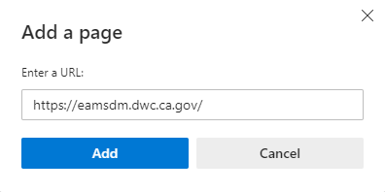
The first time you login to EAMS cont.
If you run into any issues when trying to access FileNet, you may need to add the following URL to the list of acceptable websites: FileNet URL.
Complete steps 1-4 on the Accessing EAMS in Microsoft Edge Internet Explorer Mode guide.
In the Default Browser section click on the Add button for the Internet Explorer mode pages.
Enter the FileNet URL to the Add a page window and click the Add button to complete the entry.

Slide 26
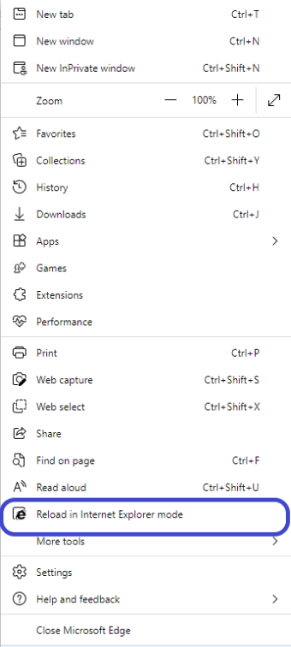
EAMS System Settings
Please note that unless overridden by your system administrator that the IE mode settings in Microsoft Edge may expire after 30 days. If this occurs, simply go to the Settings and more drop down menu (…) in the upper right-hand corner and select to Reload in Internet Explorer mode.

Slide 27
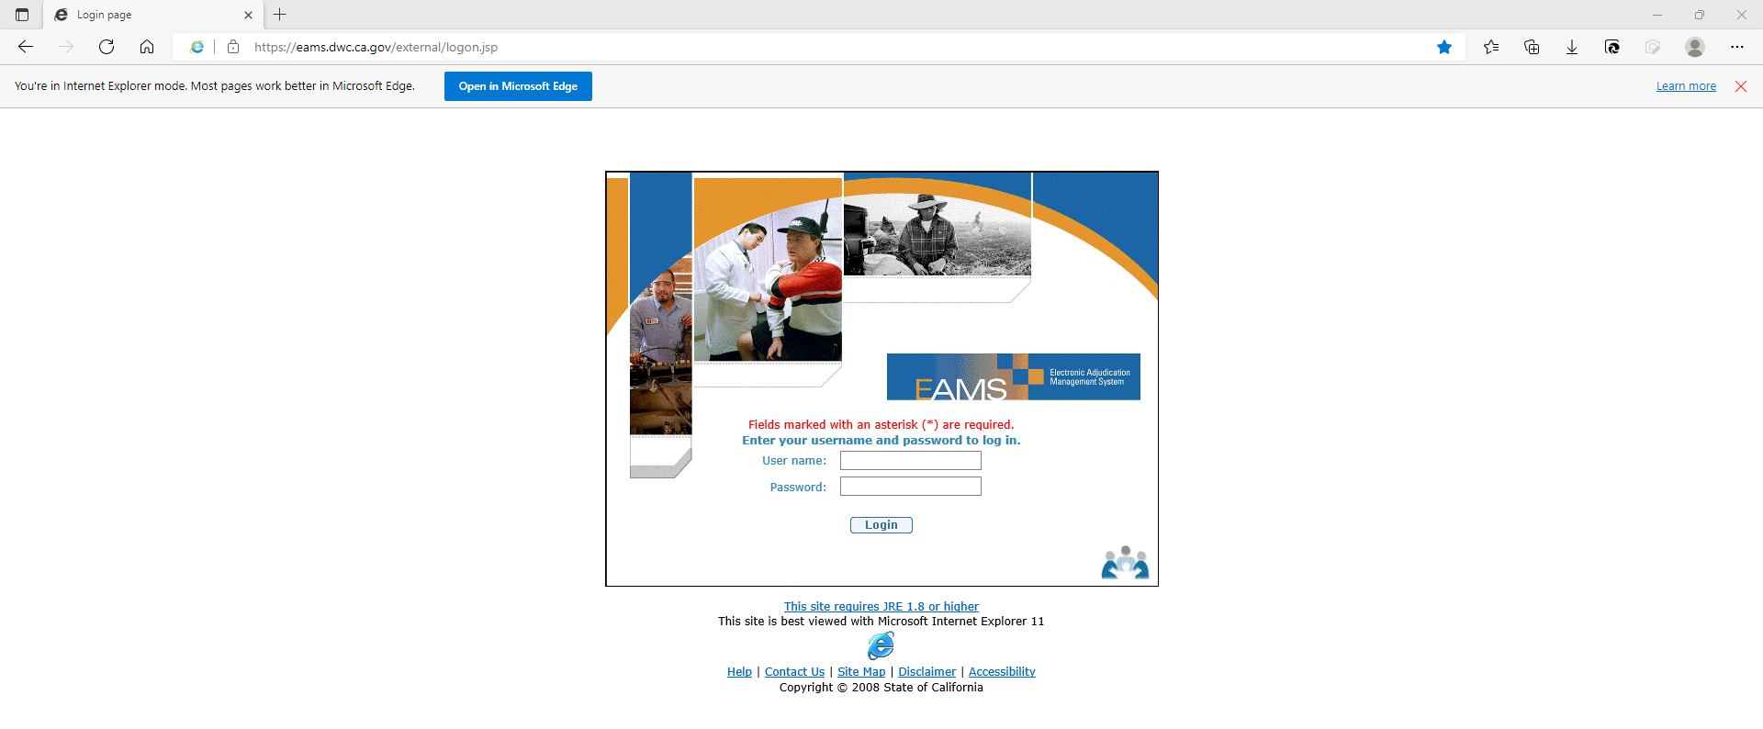
Login Page
Main EAMS website

Slide 28
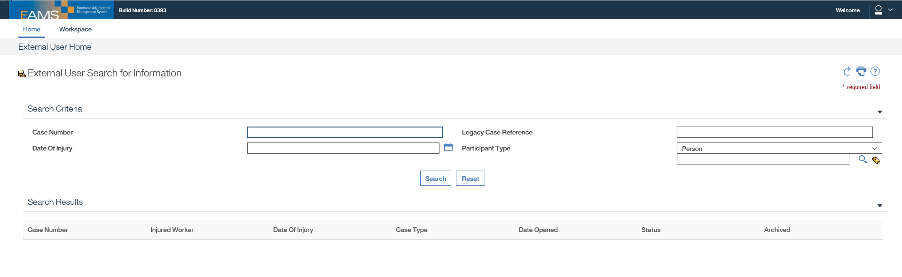
External Home Page
When searching is best to use either the case number or the Person, but not both.
Never search by the date of injury (DOI).

Slide 29
Search for your case
Two methods to find your case:
  By EAMS Case Number
  By Person or Employer Search
If you are not already a case participant, please email the EAMS Help Desk (EAMSHELPDESK@dir.ca.gov) for assistance or check the Reference Guide.

Slide 30
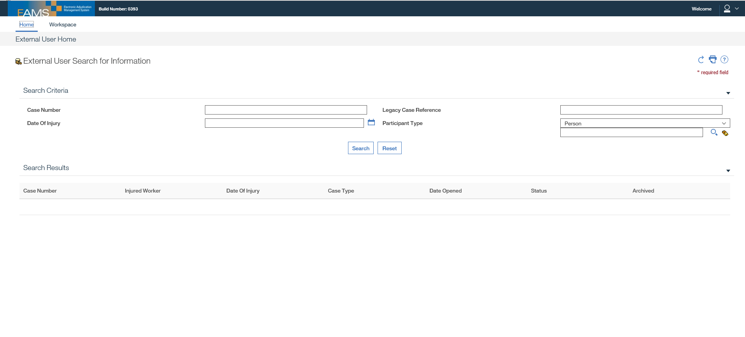
Search by EAMS Case Number
Then Click Search.
Enter the EAMS ADJ Case Number.

Slide 31
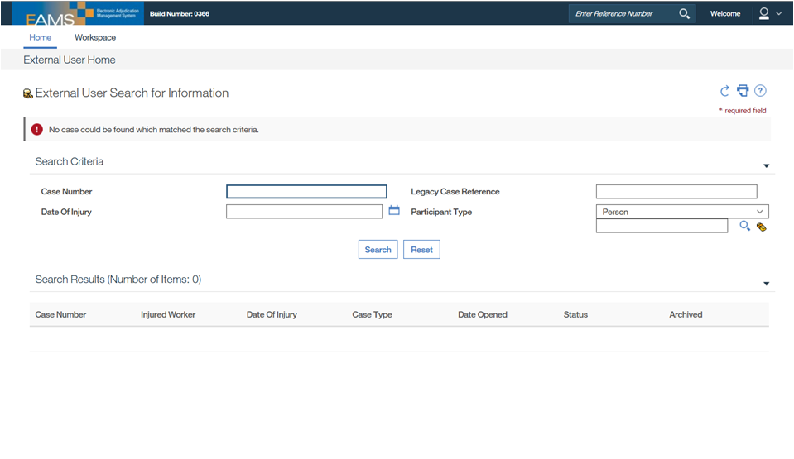
Search by EAMS Case Number – Error
If you are not a case participant, you will get this message. You will also get this message if you typed in the incorrect case number. If you think this is a system error, then please email the UDQ Supervisor at EAMSHELPDESK@dir.ca.gov for assistance.

Slide 32
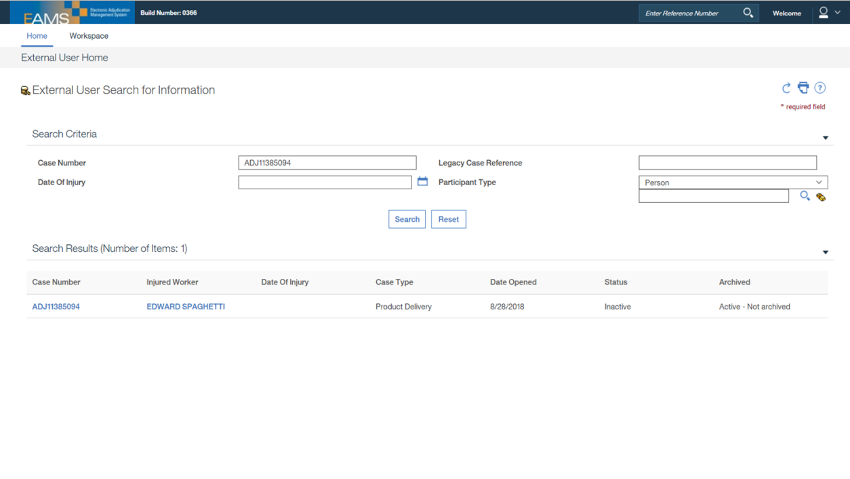
Search by EAMS Case Number – Result
If you are a case participant, you will receive these search results.
Clicking on the Injured Worker name will generate an error message.
Click on the ADJ Case Number to see case information.
See Reference Guide for steps to take If this field says “Archived.”

Slide 33
Search by person
Three search methods:
  By Reference Number a.k.a. EAMS Reference Number (ERN)
    Every Person or Employer is assigned an ERN
      A person is usually an Injured Worker (IW)
      An employer is an organization, such as an injured worker’s employer, claims administrator, insurance carrier, law firm, or lien claimant.
  By Alternate ID
    Social Security Number
  By Name
    This works best if you also include the Date of Birth (DOB).

Slide 34
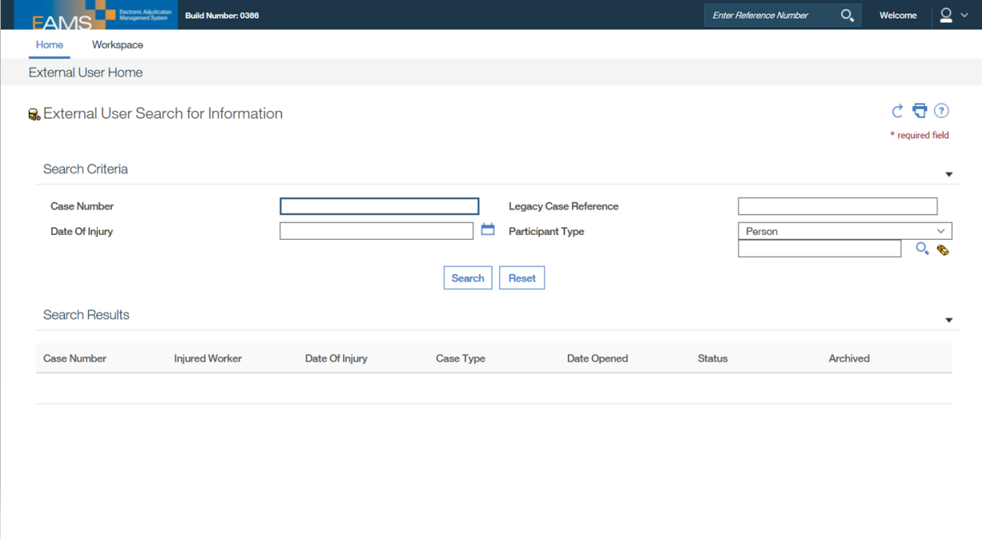
Search by person cont.
Click on the Magnifying Glass to search, because you cannot type in your entry on this screen.

Slide 35
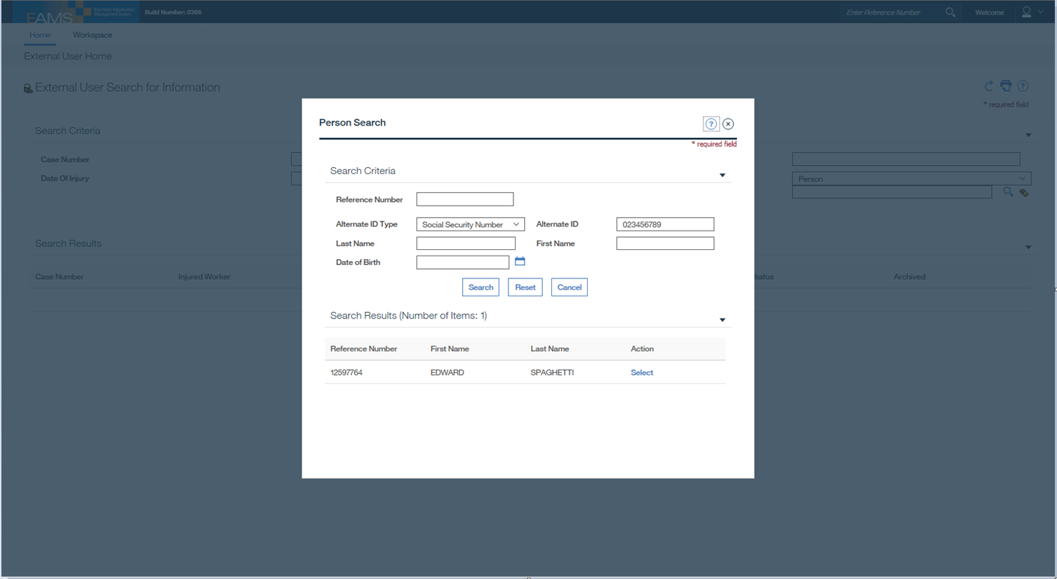
Search by person – Alternate ID (SSN)
1-Click on drop down arrow
2-Select Social Security Number
3-Enter SSN in Alternate ID field
4-Click on Search

Slide 36
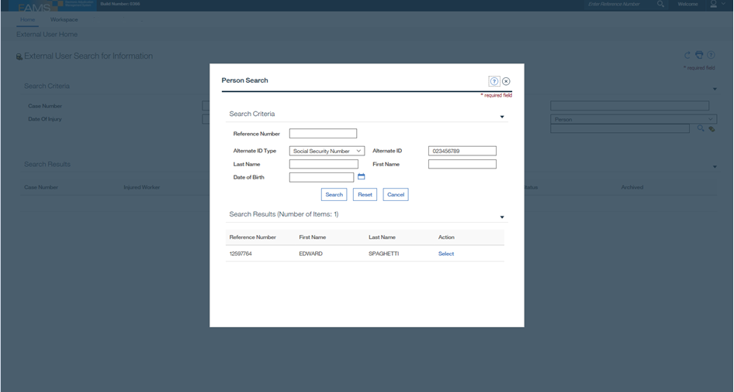
Search by person – Alternate ID (SSN) Review
Then click on Select to review.

Slide 37
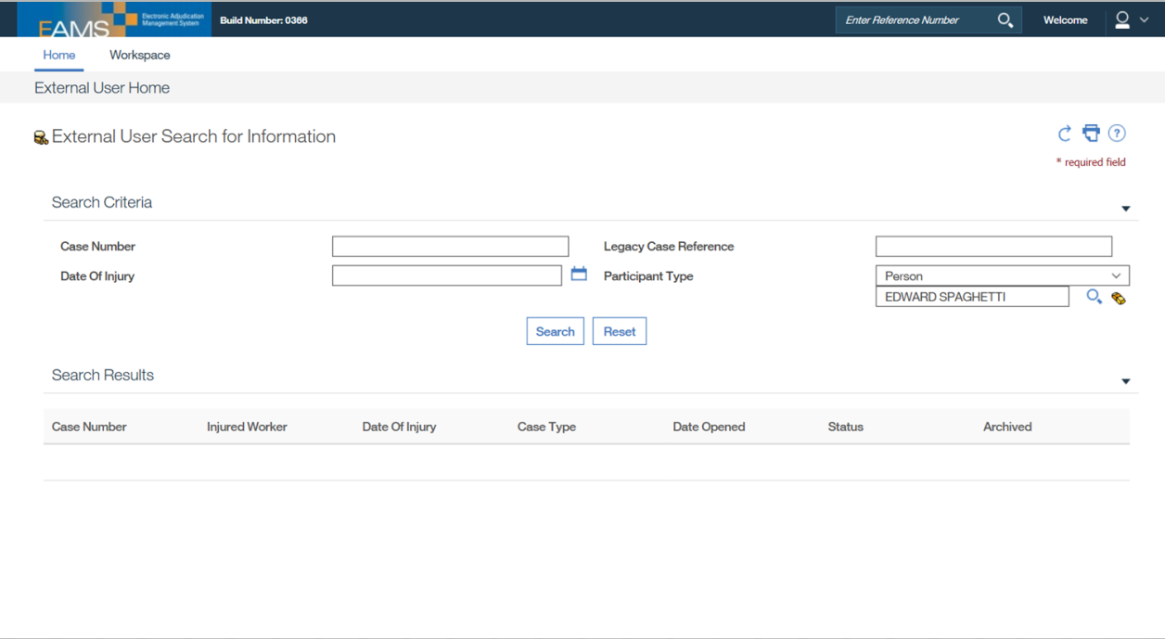
Search by person – Alternate ID (SSN) Review cont.
Then click on the Search button.

Slide 38
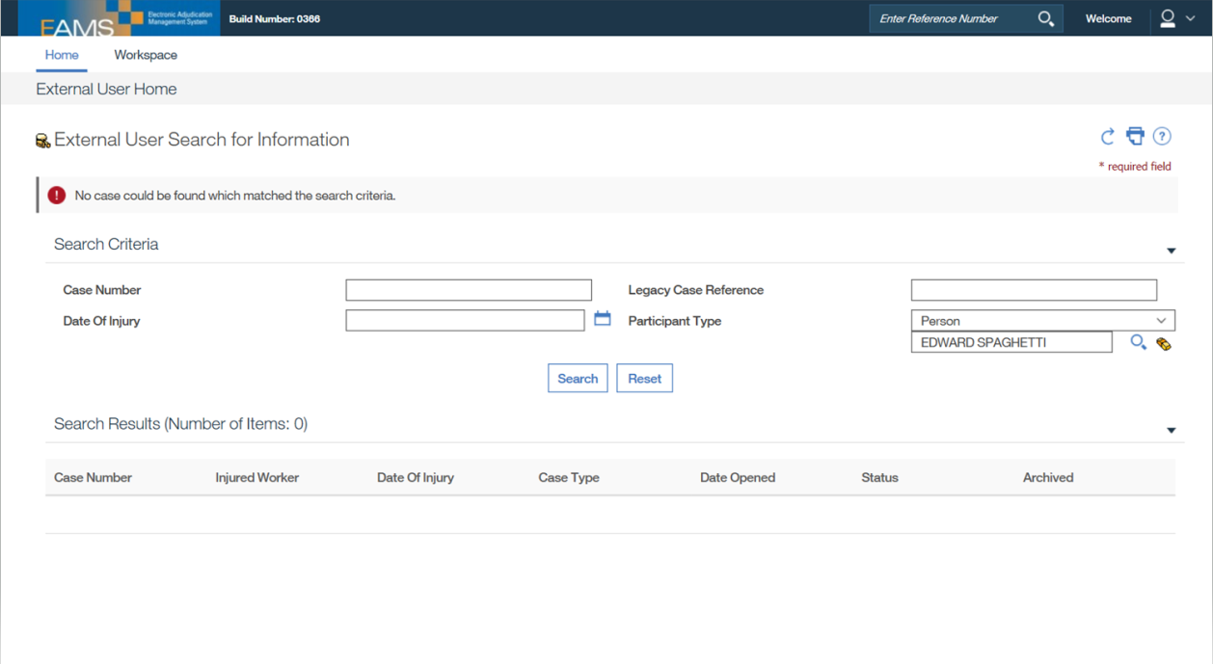
Search by person – Alternate ID (SSN) Error
If you are not a case participant, you will get this message.

Slide 39
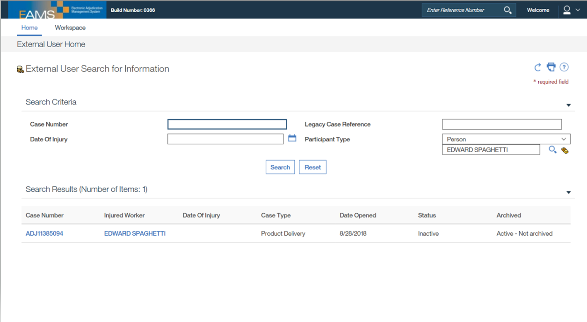
Search by person – Alternate ID (SSN) Result
If you are a case participant, you will receive these search results.
Click on the ADJ Case Number to see case information.
See Reference Guide for steps to take If this field says “Archived.”

Slide 40
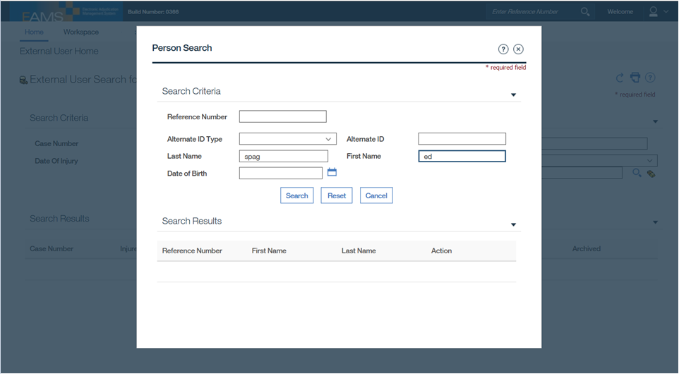
Search by person – Name
Enter the person’s last name and first name.
Then click on Search button.

Slide 41
Search by person – Name cont.
When searching by name you can enter someone’s full or partial name, but less tends to be better.
Whether you use a full or partial name in your entry, you may receive multiple matching results.
If you receive multiple results, click on each one until you locate the one that you are listed as a case participant.
Another way to refine your search results is to include the date of birth (DOB).

Slide 42
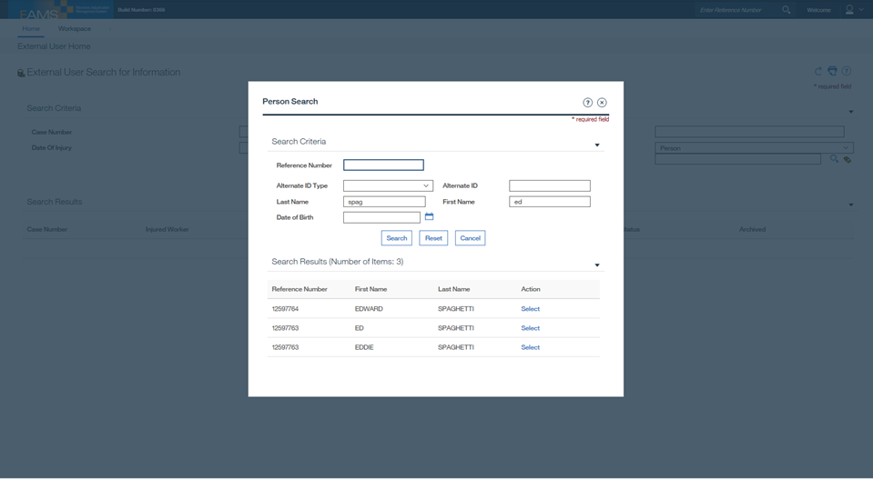
Search by person – Name List

Slide 43
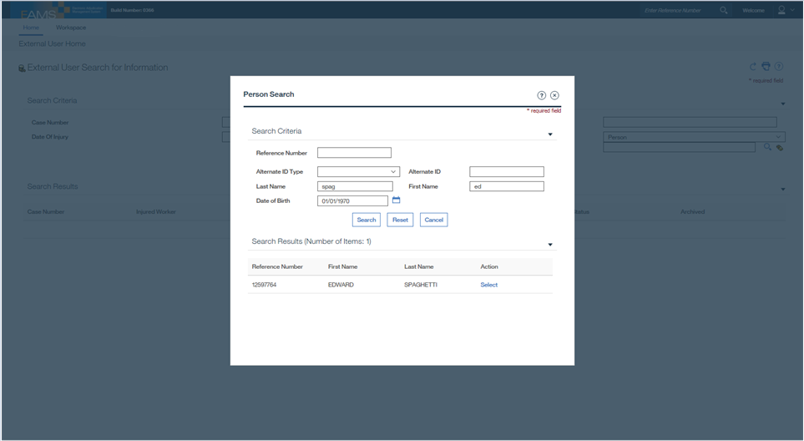
Search by person – Name Filter
Here, we entered the DOB with a last and first name to better refine our search. You can manually enter the DOB or use the calendar to select the date.
Then click on Select to review.

Slide 44
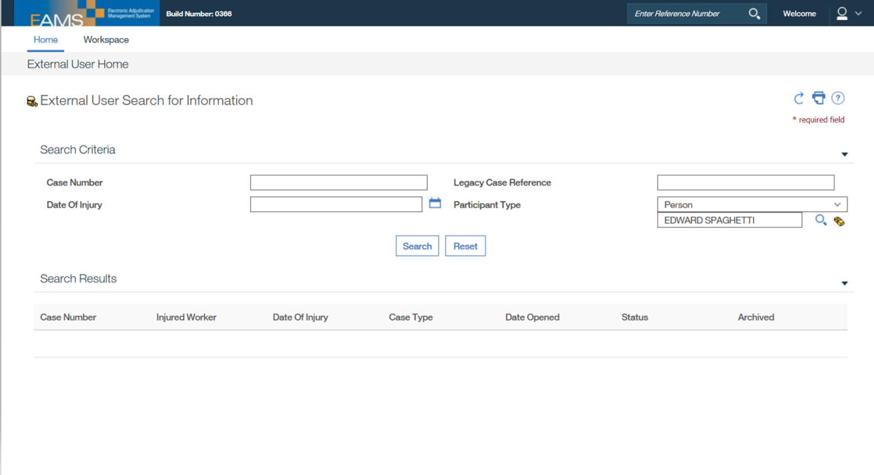
Search by person – Name Review
Then click on the Search button.

Slide 45

Search by person – Name Result
If you are a case participant, you will receive these search results.
Click on the ADJ Case Number to see case information.
See Reference Guide for steps to take If this field says “Archived.”

Slide 46
ADJ Home Page
Once you arrive at the ADJ Home Page you will see a variety of options and links, not all of which will be accessible to you.
It is from this page that you can access the INT or Integrated Page link by clicking on the Related Cases heading.
Filenet Documents is another frequently utilized link to access the repository where documents filed for a particular case are stored.

Slide 47
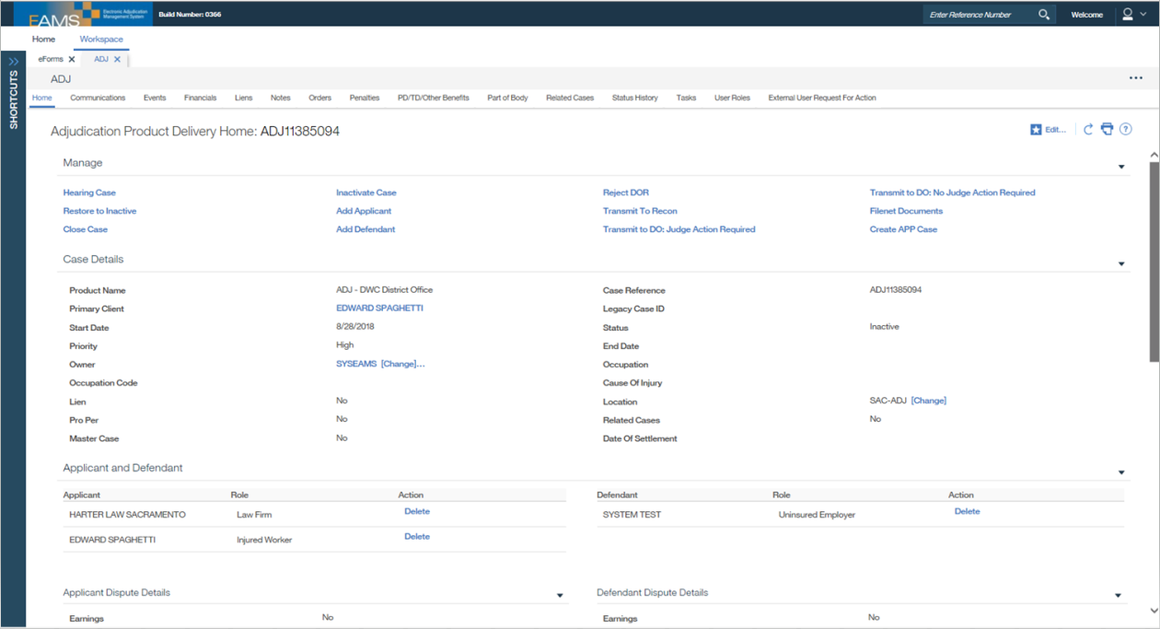
ADJ Home Page cont.
Click the Related Cases heading to access the INT or Integrated Case Page.
Click the Filenet Documents link to access the document repository for this case.

Slide 48
Filing eForms
Notes:
48

Slide 49
Preparing to e-file
Now that you are ready to start e-filing you will want to take the time to prep your documents by pre-scanning anything that you may need to upload as an attachment.
Print and keep a copy of a blank eForm for reference so you know what information to gather before you start filling in the blanks.
Make a checklist of attachments for each type of eForms packet, so that you know what you need ahead of time.
Remember to not use any special characters or extra spaces in your entries as this will cause inaccurate entries to be incorporated into the case file.

Slide 50
Preparing to e-file cont.
Be sure to review the Reference Guide as well for other helpful tips and tricks. It is under revision, so please be advised that the information provided in these slides includes the most current guidelines.
The eForm filers webpage provides a central location to find information on signing up for e-filing, resource guides, and even some answers to frequently asked questions (FAQs).
If you have any questions, please contact the EAMS Help Desk (EAMSHELPDESK@dir.ca.gov) for assistance.

Slide 51
External Login Page
Do not click on the Open in Microsoft Edge button.

Slide 52
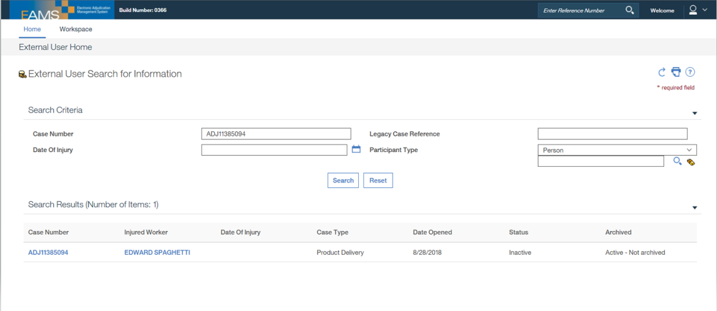
External Home Page – eForms link
Once you have successfully logged in and arrived at the Home Page, you can click on the Workspace link to locate the available eForms.
Click on the Workspace link.

Slide 53
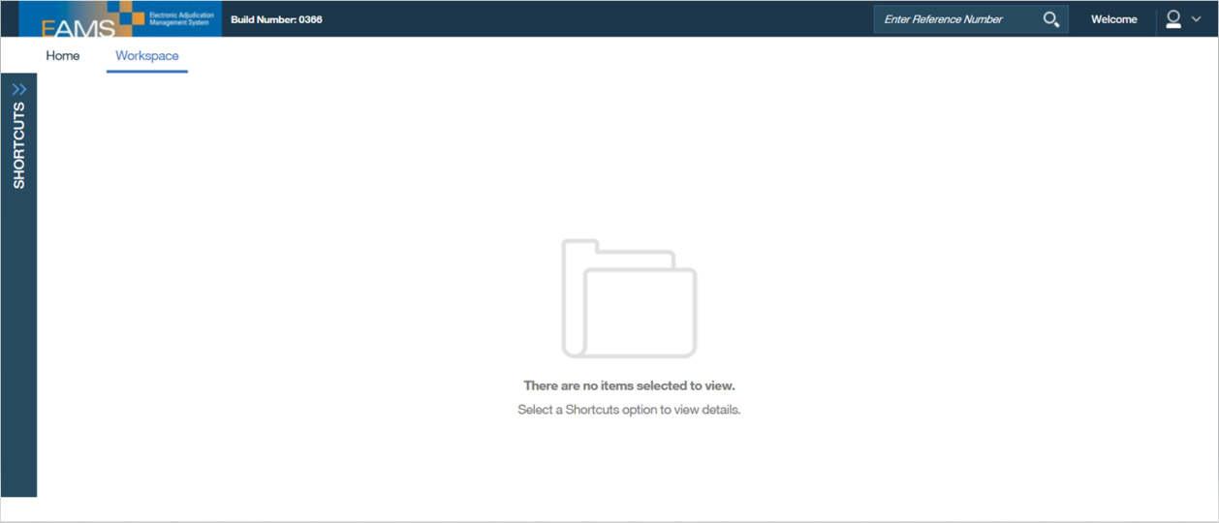
External Home Page – eForms link cont.
If the Shortcuts bar on the left-hand side is not fully expanded, click on the “>>” to open this section and then click on the eForms link.
Click on the “>>” to open the Shortcuts.

Slide 54
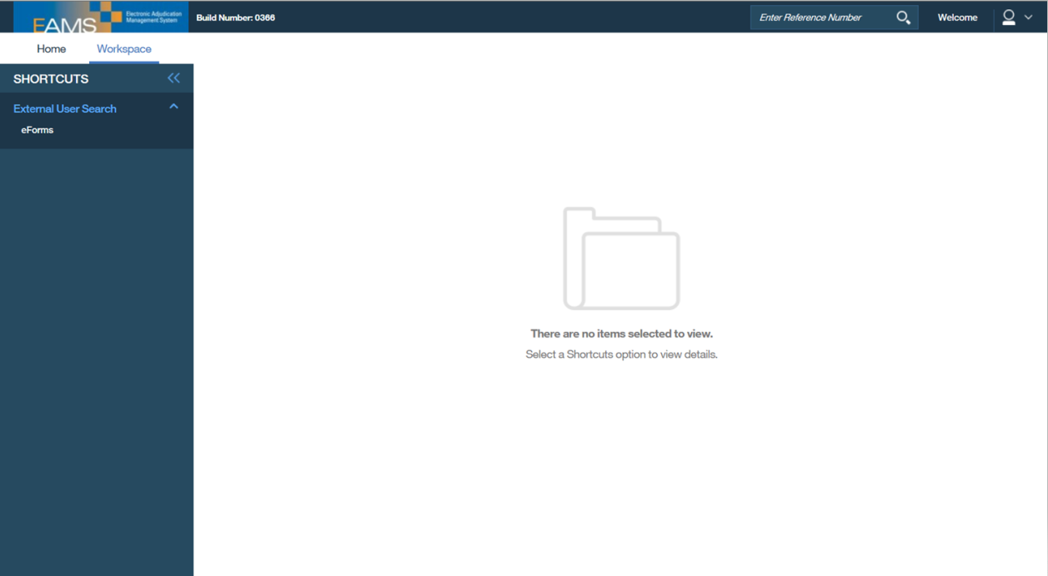
External Home Page – eForms link cont.

Slide 55
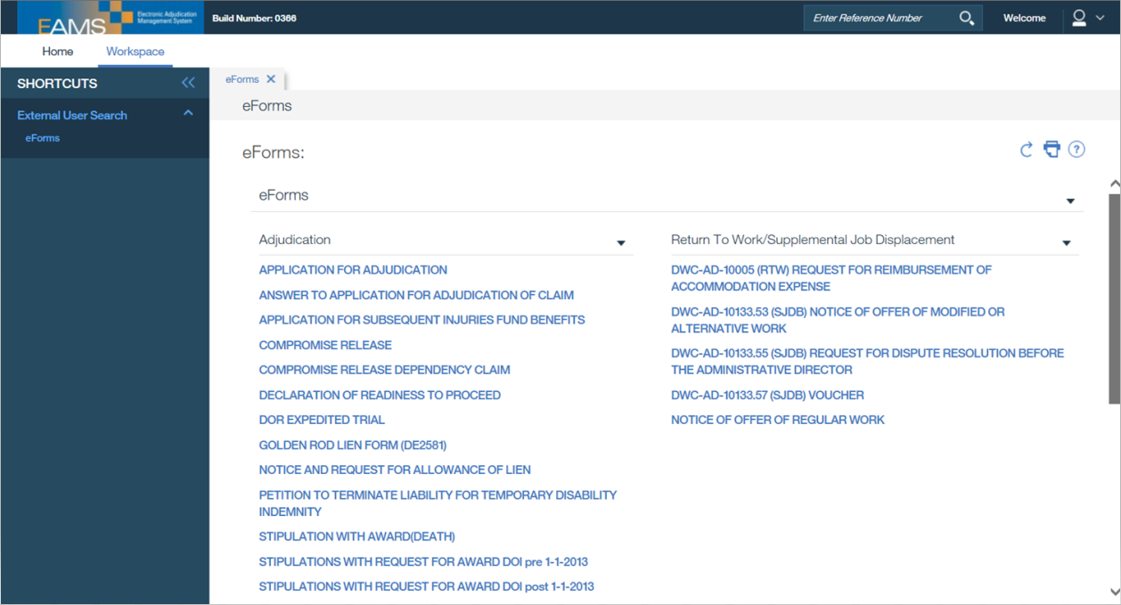
eForms Page
These are all “structured” eForms, and anything that is not listed here will need to filed through the UNSTRUCTURED EFORM link at the bottom of the page.

Slide 56
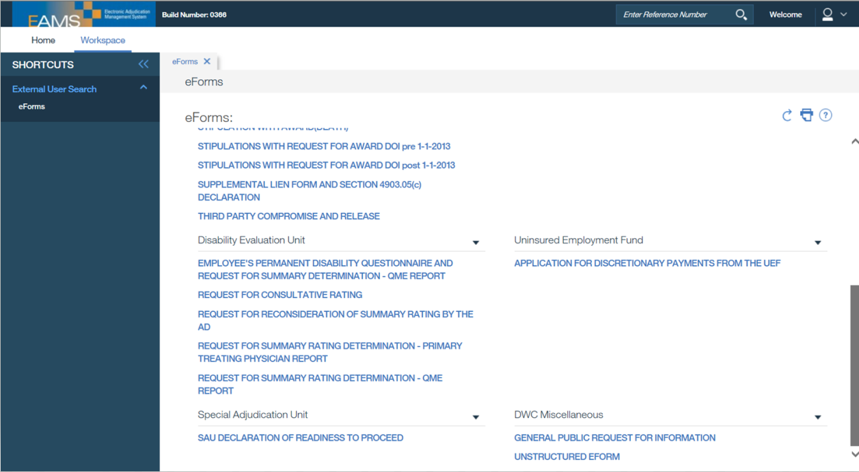
eForms Page cont.
Use the UNSTRUCTURED EFORM when filing a document that is not on the existing list of structured eForms.

Slide 57
eForm Layout
Each structured eForm starts with a Document Coversheet, that has five tabs that can hold information for up to 15 companion cases.
  Attachment should only be clicked once you are ready to attach your documents to the eForm. Do not submit the eForm and then prepare your attachments as separate unstructured eForms.
  The Print PDF link allows you to save the eForm to your computer and to print the eForm, but it does not print or save the attachments. Always make sure you save and print a copy for your records.
  Do not click the Submit link until you have printed and/or saved your eForm.
  The Location field in the upper right-hand corner should always be listed as CTL.
  Radio buttons cannot be unclicked.
The number of tabs for an eForm will vary from one eForm to the next.

Slide 58
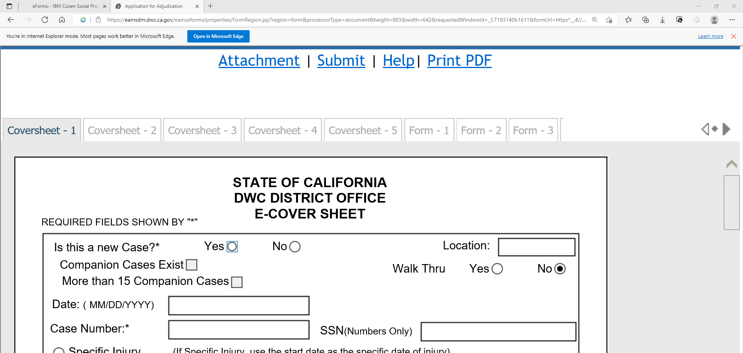
eForm Layout cont.
Use the arrows to navigate through the tabs.
This is the first page of the eForm.
This is the first page of the Document Coversheet.

Slide 59
eForm Layout cont.
Always enter CTL in the Location field.

Slide 60


eForms: DEU 101 and DEU 100
DEU-101 (Request for Summary Rating Determination) and DEU-100 (Employee’s Disability Questionnaire) are in “one” eForm.

Slide 61
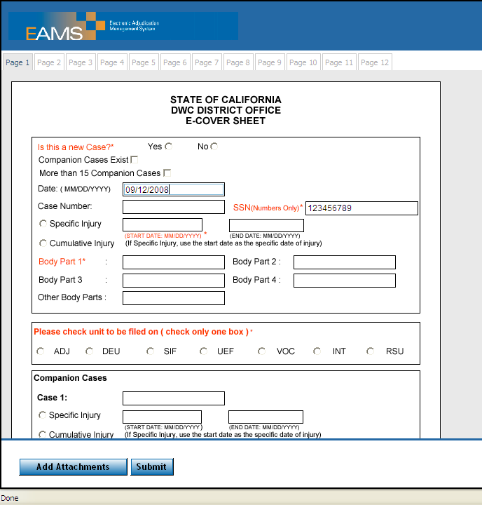
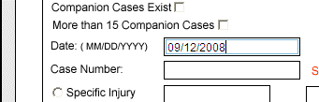
eForms: Date Format
Dates MUST be in MM/DD/YYYY format – with leading “0” when a single digit month or day.

Slide 62
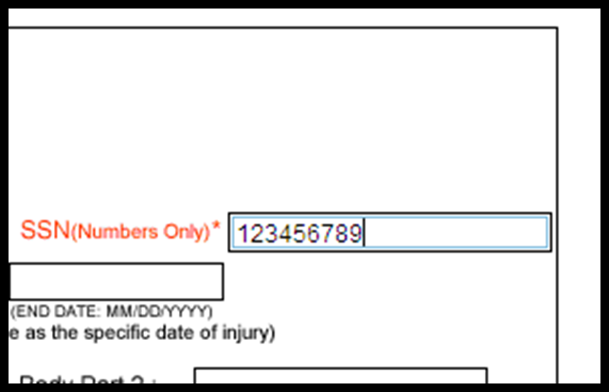
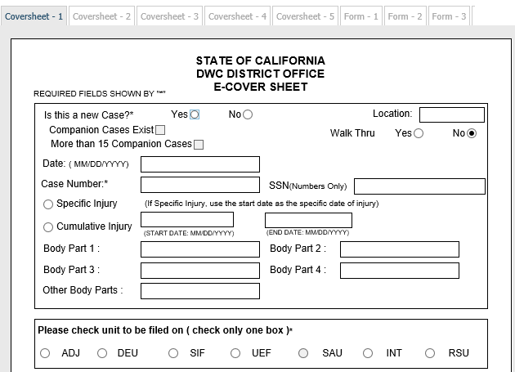


eForms: Social Security Number (SSN)
SSN is NOT a required field and only enter this information if authorized to do so on case opening eForms. Remember no spaces or dashes and include all nine digits.
No partial or incorrect entries.

Slide 63
eForms: No Companion Cases
If there are no companion cases, fill out Coversheet 1 and then click on the tab for Form 1. Do not check the “Companion Cases Exist” checkbox unless you are listing companion cases in which the eForm and its attachments are to be filed.
Never list companion cases on the coversheet for the following eForms:
  Notice and Request for Allowance of Lien
  Application for Adjudication
  Answer to Application for Adjudication of Claim
The Request for Rating Summary Determination eForm does allow established DEU Companion Cases to be listed and the Proof of Service should be included as an attachment.

Slide 64
eForms: No Companion Cases cont.

Slide 65

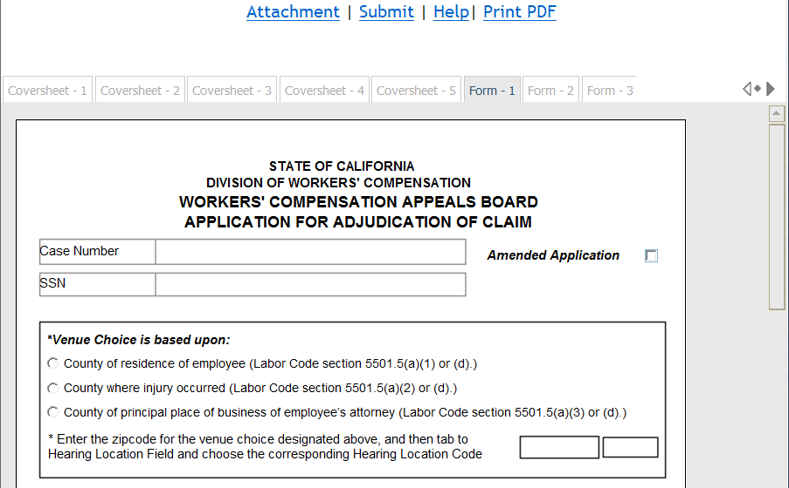
eForms: Venue Location
When filling out Form 1 (page 1) of the Application for Adjudication of Claim, Compromise & Release, or Stipulation with Request for Award, the ZIP Code determines the Venue.
Click to Restore down if you are unable to view the navigational arrows.

Slide 66
eForms: Venue Location cont.
The zip code entered must match the zip code in the eForm corresponding section/field.
For example, if the venue is based on the Residence of the IW, the zip code in this top venue section must match the IW zip code in the body of the eForm.

Slide 67
Case Number
The biggest source of issues with case numbers is due to typing errors, especially on the Unstructured eForm.
  Remember no extra spaces or special characters
  Double check that everything is entered correctly, because one transposed digit can land a file in the UDQ.
ADJ case numbers NEVER have a zero for the first digit.
Do not put “ADJ” in front of the Legacy Case Number (See page 19 of the Reference Guide).
  EAMS and Legacy Case numbers can be looked up on the DIR website.
Do not enter both the ADJ and Legacy Case Number.
  Example: Do not put the EAMS ADJ number in the main case field and the corresponding Legacy case number in the companion case field – they are the same case.

Slide 68
Companion Cases
Do not select the radio button “Companion Cases Exist” nor enter any companion case numbers for:
  Application for adjudication of claim
  Amended application for adjudication of claim
  Answer to application for adjudication of claim
  Lien claims

Slide 69
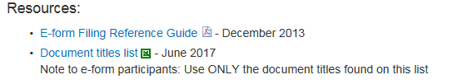
Document Titles
Use the correct document titles
Refer to the Document Type and Title list on the eForms webpage under Resources - Document Titles Spreadsheet.
Never use Exhibit or Evidence Document Titles – these are for internal use only and refer to the spreadsheet for titles available to external users.
Scanned settlement documents use:
  ADJ – LEGAL DOCS – COMPROMISE AND RELEASE-SIGNED
  OR
  ADJ – LEGAL DOCS – STIPULATIONS WITH REQUEST FOR AWARD-SIGNED

Slide 70
Fields
If there is no information to enter in a field, LEAVE IT BLANK!
For example:
  SSN: If you are not authorized to include this information or if you do not have it, do not type “NONE” or “N/A.”
  New case: In the case number field do not type “UNASSIGNED”
  Self-insured employer: Do not type “NONE” or “SELF-INSURED” in the Insurance Carrier name field.
Remember that it is better to LEAVE IT BLANK if you are unsure or if you do not have this information!

Slide 71
Filing Date
The filing date for batches is based on business hours, so anything successfully submitted after 5:00 p.m. on Monday through Friday will generally roll over to the following business day.
Batches submitted on a Saturday or a holiday will be assigned a filing date that is on the next DWC business day.

Slide 72
Labeling your Documents
Do not use “EXHIBIT”, “EVIDENCE” “APPLICANT 1” etc. as your file name.
  Remember that you want the judge or the District Office staff to easily recognize what you are trying to file, so keep it simple and straightforward.
  It must make sense to anyone reading it in FileNet
    For example: “LSSPOFS” or “A273458353.pdf” is not clear to anyone except the person that created the file.
  When in doubt spell it out, because there is plenty of space in the file name field, but remember to avoid using special characters.
    For example: If you use an underscore “_” in your file name, EAMS will shorten everything after this character.

Slide 73
Labeling your Documents cont.
Commonly accepted abbreviations:
  Signed C&R Compromise and Release
  Signed Stips Stipulations with Request for Award
  NOR Notice of Representation
  Pet 5710 Petition for LC Section 5710 attorney’s fee
  Pet Recon Petition for Reconsideration
  Answer-Recon Answer to Petition for Reconsideration
  Smith AME 1/4/9 Dr. Smith’s AME report of 01/04/2009
  POS Proof of Service
  PD Notice Permanent Disability Notice
  Wage Stmt Wage Statement

Slide 74
Non-mandatory fields
Filling in just the “mandatory” fields is not enough to successfully e-file.
Pre-EAMS, filers needed to fill in all the information available in order for the form to be complete and nothing has changed with the adoption of eForms.
Remember that the eForm settlement document fields need to mirror or match the fields on the scanned signed settlement document.
  Complete entries help to populate our databases. While the scanned signed settlement document is the controlling document in EAMS, without the same information in the eForm fields, our reporting databases will be incomplete, which can cause reporting errors.
  However, if there is no information to enter in a field then you should leave it blank to avoid incorrect or incomplete entries that might land the batch in the UDQ.

Slide 75
Self-Insured Employers
In the Employer section, select the radio button “Self Insured.”
Do not enter anything in the Insurance Company section on the form – LEAVE IT BLANK.
You MUST enter the Claims Administrators’ Office UAN and address.
  If they self administer their claims, enter their UAN and address
  If they use a TPA, enter the TPA’s UAN and address
The Uninsured Employers Benefits Trust Fund (UEBTF) is not an insurance company or a claims administrator. UEBTF will be joined to a case only after a petition is filed and the WC judge issues the accompanying order.

Slide 76
Application form package
Application for Adjudication of Claim eForm
  All filers should include:
    4906(h) – ADJ-LEGAL DOCS-4906(h) DECLARATION
    Proof of Service – ADJ-LEGAL DOCS-PROOF OF SERVICE
  If filed by a Representative for the Injured Worker include:
    Fee Disclosure Stmt: ADJ-LEGAL DOCS-FEE DISCLOSURE STATEMENT
    Venue Authorization: – ADJ-LEGAL DOCS-VENUE VERIFICATION
  If filed by/on behalf of a Lien Claimant include:
    Verification– ADJ-LEGAL DOCS-VERIFICATION FOR LIEN OR APPLICATION BY LIEN CLAIMANT

Slide 77
DOR form package
Declaration of Readiness to Proceed eForm
  All filers should include a:
    Medical Report – select one* from below:
      ADJ-MEDICAL DOCS-QME
      ADJ-MEDICAL DOCS-AME
      ADJ-MEDICAL DOCS-P & S REPORT
      ADJ-MEDICAL DOCS-TREATING PHYSICIAN
        *You may file more than one medical report if there are multiple areas of the body involved, e.g. brain and hand.
        If you are filing for a Rating MSC, attach all medical reports, so that they can be rated.
        Do not file a medical report if it is already in EAMS.
    If the issue is non-medical, attach one document addressing the issue using:
      ADJ – MISC – CORRESPONDENCE-OTHER
    Proof of Service (all filers) – ADJ-LEGAL DOCS-PROOF OF SERVICE
  If filed by/on behalf of a Lien Claimant add:
    Verification – ADJ-LEGAL DOCS-VERIFICATION FOR DOR BY LIEN CLAIMANT

Slide 78
DOR form package cont.
Declaration of Readiness to Proceed eForm
  If filed by/on behalf of a Lien Claimant add:
    Verification – ADJ-LEGAL DOCS-VERIFICATION FOR DOR BY LIEN CLAIMANT
  Lien Claimants and their representatives’ offices should review the regulations to determine when they are allowed to file a DOR.
  Proposed trial exhibits are filed after the mandatory settlement conference (MSC), not with the DOR.

Slide 79
Lien form package
Notice and Request for Allowance of Lien eForm
  Verification for Lien or Application by Lien Claimant
    ADJ-LEGAL DOCS
  Proof of Service
    ADJ-LEGAL DOCS
  4903.8(d) OR 4903.8(a)(b)
    ADJ-LIENS AND BILLS
  Original Bill: All lien submissions must include an Original Bill
    ADJ-LIENS AND BILLS
File the itemized statement of charges with the lien. Remember to serve the other parties all documents.

Slide 80
Lien form package cont.
Medical liens filed on or after 1/1/2017 that require payment of lien filing fee must provide additional information in the lien form including:
  Rendering provider information
  Billing provider information
  Declaration under Labor Code Section 4903.05(c)
    The first section must be filled out; additional sections to be used only for additional providers.

Slide 81
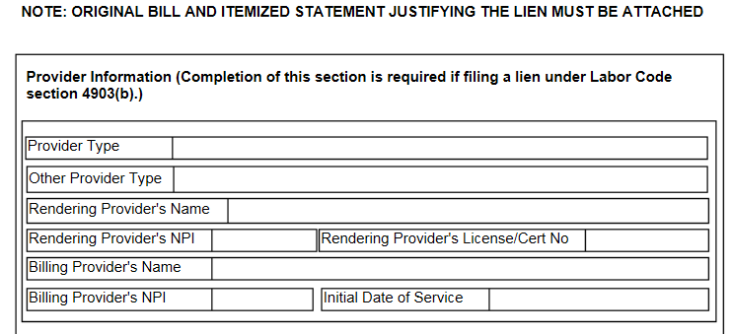
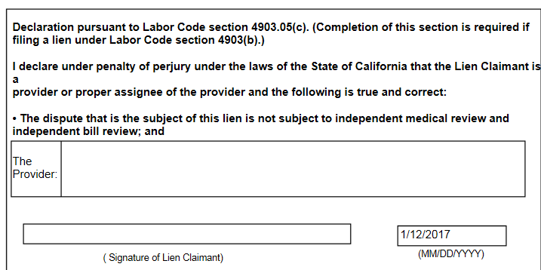
Lien Provider Information and Declaration

Slide 82
Lien updates
Previously, e-filers that filed paid liens between January 1, 2013 and December 31, 2016 were required to upload the SUPPLEMENTAL LIEN FORM AND SECTION 4903.05(c) DECLARATION for their liens to be considered valid.
The supplemental lien form and section 4903.05(c) is now built into the eForm for the NOTICE AND REQUEST FOR ALLOWANCE OF LIEN and a separate form is no longer required to file.

Slide 83
Ratings
Pro Per (unrepresented)
  Use only these eForms:
    EMPLOYEE’S PERMANENT DISABILITY QUESTIONNAIRE AND REQUEST FOR SUMMARY RATING-QME REPORT
  or
    REQUEST FOR SUMMARY RATING DETERMINATION-PRIMARY TREATING PHYSICIAN REPORT
  If you do not have a DEU case number, file it as a NEW CASE.
  When attaching a Proof of Service use the attachment link on the eForm and select DEU-MISC–PROOF OF SERVICE.

Slide 84
Ratings cont.
Represented IW
  Use DEU Prefix even if the DEU case does not exist – Guide page 54-55.
  Use only this eForm:
    REQUEST FOR CONSULTATIVE RATING
  When you attach a Proof of Service use the attachment link on the eForm and select DEU-MISC–PROOF OF SERVICE.

Slide 85
DWC-AD-10133.55
Supplemental Job Displacement Benefits (SJDB) Request for Dispute Resolution Before Administrative Director
Use RSU Prefix even if this RSU product does not exist (except for case opening forms)
  Do not file as a “new case” unless there is no existing ADJ number.
Form Package (remember to attach separately):
  RSU-SUPPORTING DOCUMENT-MEDICAL REPORT
  RSU-SUPPORTING DOCUMENT-VRTWC REPORT
    Example: Physician’s Return to Work or Voucher reports
  RSU-OTHER-OTHER CORRESPONDENCE
    Include a copy of the Settlement and Order
  RSU-OTHER-OTHER CORRESPONDENCE
    Example: Notice of Offer of Regular Modified or Alternative Work
  RSU-OTHER-PROOF OF SERVICE
    The OCR form has the POS however, this eForm does not.
    You can still use the OCR page 4 POS if you modify it to include your eForm information.

Slide 86
DWC-AD-10133.55 (SJDB) Request for Dispute Resolution Before Administrative Director cont.
Optional form Package:
  RSU-NON-FORM CORRESPONDENCE-LETTER
  RSU-SUPPORTING DOCUMENT-JOB DESCRIPTION
  RSU-SUPPORTING DOCUMENT-POSITION STATEMENT
  RSU-SUPPORTING DOCUMENT SCHOOL & VRTWC INVOICES
  RSU-OTHER-OTHER CORRESPONDENCE (SJDB VOUCHER SIGNED)
*For questions regarding status? Email DWCSJDBinquiries@dir.ca.gov

Slide 87
S Signature
Proper format:
S FIRSTNAME LASTNAME
S JOHN JONES
Do not use any slashes/dashes
Do not forget to type the person’s name
No middle names, initials, titles or punctuation

Slide 88
S Signature cont.
Should only be used on eForms – NEVER on an OCR form
A representatives’ office filing for the Injured Worker or lien claimant will use their S signature on the eForm.
  For example, this should not be the clerk’s name that is filing on behalf of the representative.
Must use the S signature on the eForm
The S signature is optional to use on:
  PROOF OF SERVICE
  VERIFICATION FOR DOR BY LIEN CLAIMANT
  VERIFICATION FOR LIEN OR APPLICATION BY LIEN CLAIMANT
Do not use on eForm settlement documents

Slide 89
Wet Signature
This is an actual signature on a document
You cannot use a GIF, JPEG, digital signature or a signature stamp – it must be an actual signature.
Example of where a “wet” signature is required:
  Petitions, Objections
  Signed OCR Settlement Documents that you scan and attach
  Documents requiring IW or employer signature

Slide 90
Signature Variations
Version I refers to forms that require only one signature:
  In this situation, prepare the eForm and attach the following to the eForm:
    Document(s) per filing package requirements
    Proof of Service: Use the Proof of Service document title – ADJ – LEGAL DOCS – PROOF OF SERVICE
DON’T FORGET THE S SIGNATURE ON THE FORM
  Proper format: S FIRSTNAME LASTNAME
  Example: S JOHN JONES

Slide 91
Signatures Variations cont.
Version II refers to forms requiring two or more signatures:
  In this situation, prepare the eForm and attach the following to the eForm
    Signed version of OCR form
    Any additional attachments that are necessary
    Proof of Service
If you come across a form that requires a signature other than your own:
  Use Version II
  Example: Employee’s disability questionnaire or Notice of Offer of Regular Work, both of which require the injured worker’s or employer’s signature

Slide 92
eForms - S signature only
Application for Adjudication of Claim
Answer to Application for Adjudication of Claim
Declaration of Readiness to Proceed
Declaration of Readiness to Proceed - Expedited
EDD Golden Rod – 2581
Notice and Request for Allowance of Lien
Petition to Terminate Liability for TD
Request for Reimbursement of Accommodation Expense
Request for Dispute Resolution before the AD
Request for Summary Rating – QME
Request for Reconsideration of Summary Rating by AD
Request for Summary Rating Determination - PTP

Slide 93
eForms – Two or more signatures
Compromise and Release
Compromise and Release Dependency Claim
Stipulation with Award (Death)
Stipulations with Request for Award
Third Party Compromise and Release
Notice of Offer of Modified or Alternative Work
Voucher (IW only)
Notice of Offer of Regular Work (employer/IW only)
Employee’s Permanent Disability Questionnaire (IW only)
Application for Discretionary Payments from the UEBTF (IW only)

Slide 94
eForms with No signature Line
Request for Consultative Rating
Unstructured eForm

Slide 95
OCR Documents
Do not attach the corresponding OCR form to your eForm:
  Except when filing:
    Settlement Documents
    Death Application (Pre-OCR legacy form)
  Even when OCR forms are permitted as an eForm attachment, do not include OCR Coversheets and Separator Sheets as part of the attachment.

Slide 96

Attachments to an eForm
When submitting an eForm that will have attachments:
Use the Attachment link at the top of the page
Do not submit the eForm and then fill out an unstructured eForm unless:
  You realize that you forgot an attachment after you clicked Submit. If this happens start by verifying that the document is in FileNet and then file the missing attachment using the Unstructured eForm.

Slide 97
Attachment Bundling
Do not file the following documents separately. Scan these together as a single document/attachment:
  Benefit Notices – you can separate TTD from PD notices
  Explanation of Benefits (EOBs)
  L C 4906(h) statements
  Medical Management Reports
  Physical Therapy Notes
  PR-2 Reports
Use of TTD is the exception with some of the PR-2 reports filed as separate documents.

Slide 98
Unstructured eForm
Do NOT prepare an OCR Document Coversheet and/or Document Separator Sheets and scan them with the unstructured document you are submitting.
The Unstructured eForm combines the Coversheet and Separator sheets for the e-filer.
Any field with a red asterisk (*) is a mandatory field.
The Author field is not required, but DWC judges expect this to be filled out, because it is used for sorting purposes.
After you enter the case numbers, it is recommended that you take a screenshot (press Alt + PrtScn) and paste it to a Word document. Then complete the remaining fields.
To add a file click on Browse to locate the document.

Slide 99
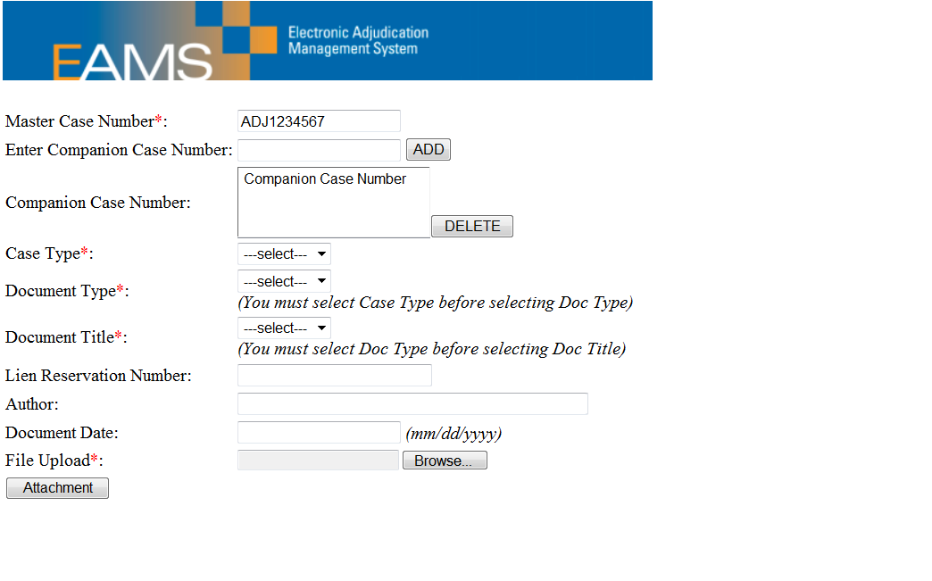
Unstructured eForm – Entry
After you click “ADD” the companion case number(s) moves to this field.

Slide 100
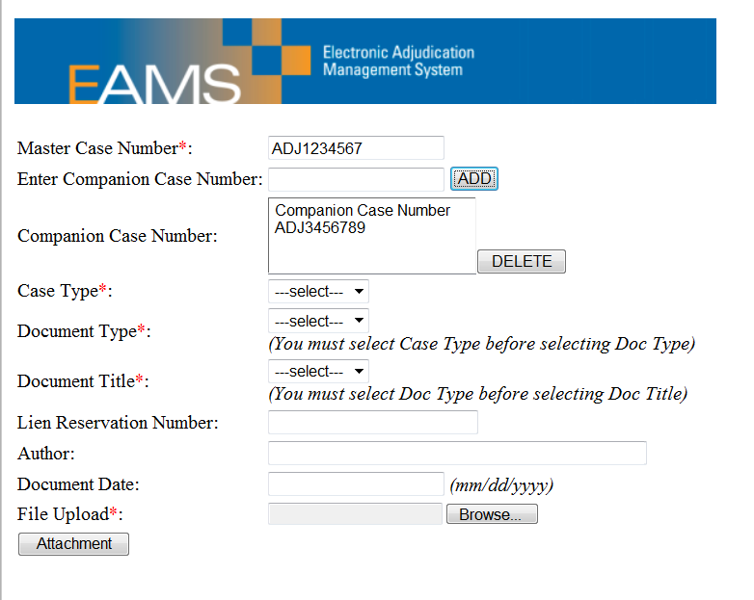
Unstructured eForm – Entry cont.
Enter ONLY Case Numbers Here – Do NOT enter IW name – this is where you add companion case number(s).
If it is a document your office prepared, enter your UAN; if a medical report, the practitioner’s name; if subpoenaed records, the name of the facility; if it is a document from a claims administrator office, their UAN; if it is a document from an employer, the employer’s name; if it is a document from an entity with a UAN, their UAN.

Slide 101
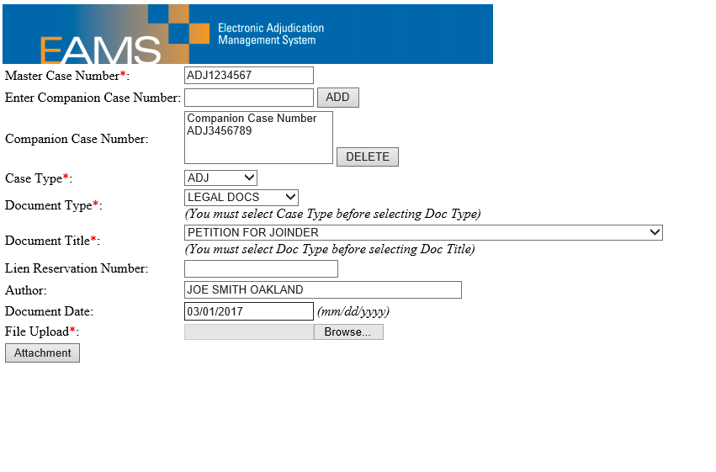
Unstructured eForm – Select File to Attach
Once you are ready to add the file, click on the Browse button.

Slide 102
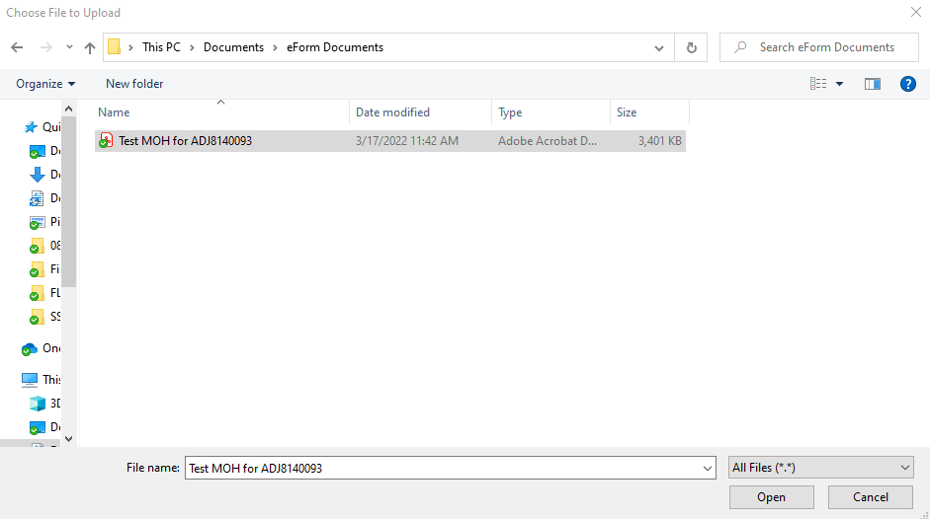
Unstructured eForm – Select File to Attach cont.
Once you have located the file, click on it and then click on the Open button.

Slide 103
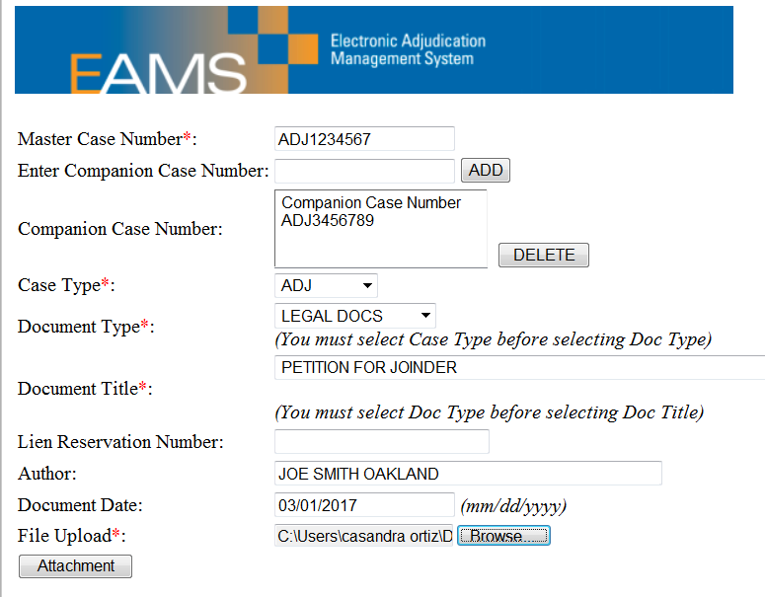
Unstructured eForm - Attachment selected
Click on the Attachment button to continue the uploading process.

Slide 104
Unstructured eForm with Multiple Attachments
When filing multiple attachments you will use the same case number and document date each time, but include the date in the file name if there are varying dates.
The larger the attachment size the longer it will take to load.
  While you can technically file an Unstructured eForm with 40 attached documents it is recommended that you do not do so, because the upload time will be lengthy, which will probably cause you to timeout. This will send your batch directly to the UDQ.
  It is suggested that you include no more than five Unstructured documents in a batch.
  It is easier to refile a smaller batch then to have to reenter all of the information for a larger Unstructured batch with multiple trial exhibits.
Look out for errors, because in the following slide you will see that one transposed digit can throw off the case number, which will cause the entire batch to fail.

Slide 105
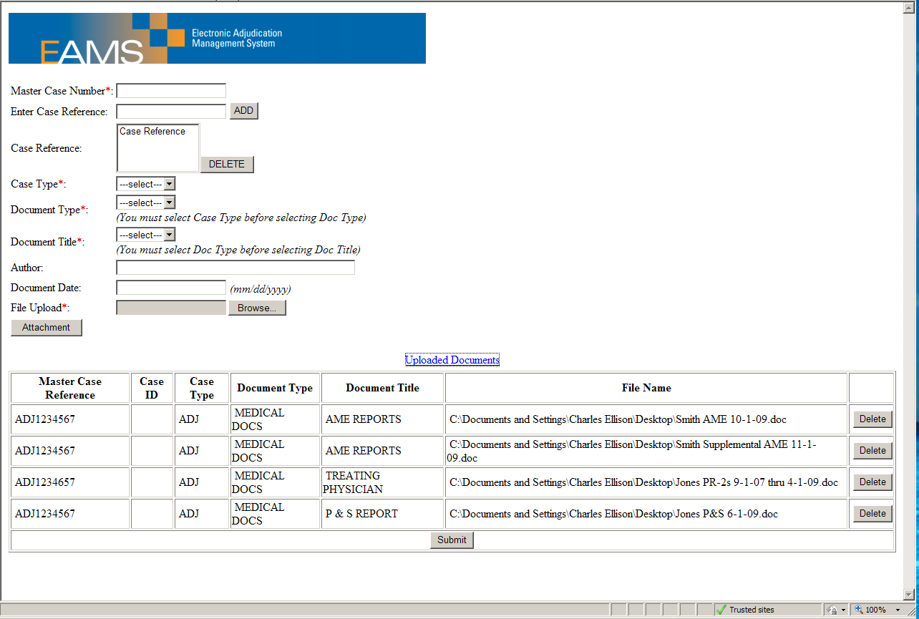
Unstructured eForm with Multiple Attachments cont.
Pay attention to the dates in the File Name and look for the error in the case number field.

Slide 106
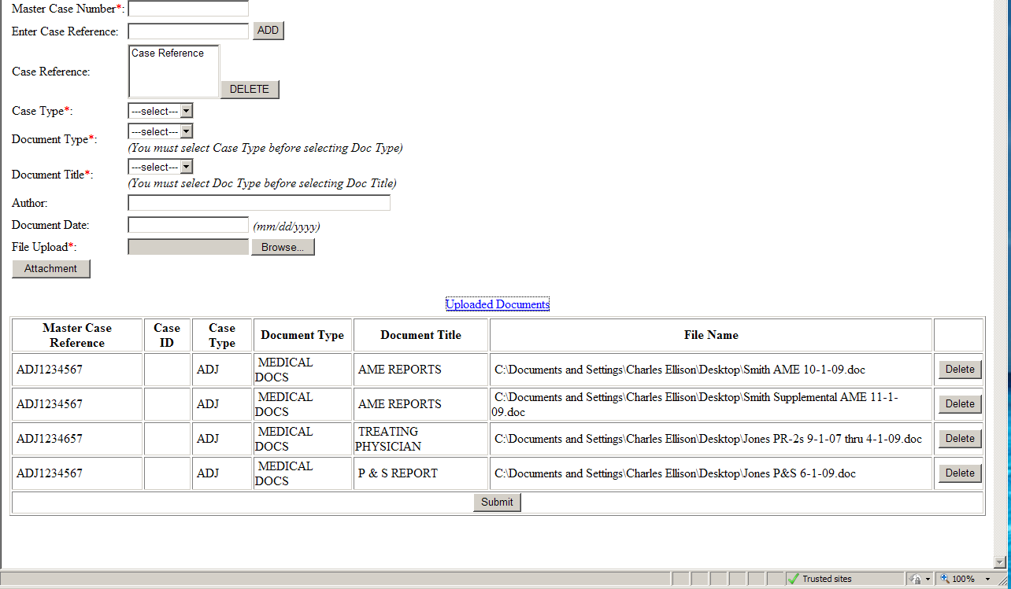
Unstructured eForm Incorrect Case Reference
All it takes is one wrong digit or character to cause a batch to fail.

Slide 107
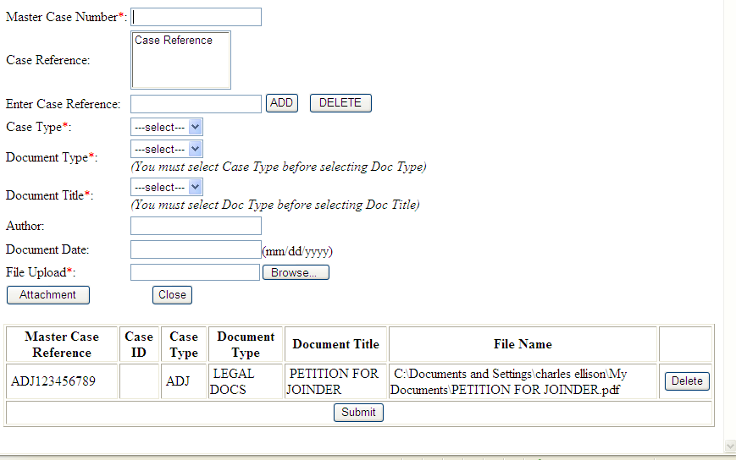
Unstructured eForm - Ready to Submit
Notice that the screen appears a little different once an attachment has been added. You can continue to upload other files until you are done. If you make a mistake and upload the wrong file, then you can click on the delete button to remove this entry.
It is recommended that you take another screenshot (press ALT + PrtScn) and save it to a Word document before clicking the submit button, because you cannot save or print the PDF.

Slide 108
eForms: Document Service
If you have to serve documents to other parties, you will need to print your eForm.
Use the “print PDF” function on the form to print all at once and/or save to your hard drive.
You only need to print the pages where you have filled in data.
Remember to PRINT BEFORE YOU CLICK SUBMIT. Also, save to your computer first and then print.
If you do click submit before you print a copy, you will need to wait for the next batch run to check the case to confirm that the paperwork was uploaded to FileNet. If so, you can then opt to print it from EAMS.

Slide 109
eForms: Batch Run Schedule
Batch runs will initially process workflow - events and tasks. Images will show up in FileNet after these processes are complete.
Current EAMS Batch Run Schedule:
  Monday through Friday*:
    AM: 6:30, 7:30, 8:30, 9:30, 10:30, 11:30
    PM: 12:30, 2:30, 3:30, 4:30, 5: 30, 6:30, 9:00
    *Except holidays

Slide 110
Proof of Service
Your proof of service requires the following in the upper left hand corner:
  Uniform Assigned Name
  EAMS Primary Administrator’s Name
  EAMS Primary Administrator’s Phone – Direct or with Extension
  EAMS Primary Administrator’s Email
  See instructions in the Reference Guide
    Please remember that the Reference Guide is under review, so the instructions provided in this presentation may not always match. If you run into this issue, please follow the guidelines in this presentation as they are the most current.
    If you are unsure about what to do please contact the EAMS Help Desk for assistance (EAMSHELPDESK@dir.ca.gov).

Slide 111
Proof of Service cont.
If you are attaching a list of the case participants you are serving, include it as an additional page of the proof of service and scan all the pages together, so you only have one file packet.

Slide 112
eForm Submission
Completion of eForm submission will generate a batch ID#
Print batch ID# or save as a text document and keep it for future reference
Verify next day to see if your eForm was successfully submitted in case
Don’t see it?
E-mail EAMSHELPDESK@dir.ca.gov with the submitted information so we can research what happened to the eForm – remember, only the Primary Administrator can e-mail the EAMSHelpDesk.
(Please include Batch ID #, case #, IW’s name, and type of eForm submitted, screenshots, when appropriate, and your contact information including your UAN and ERN.)

Slide 113
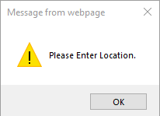
eForms: Errors
If you enter a future date in a required field, or fail to enter information in a required field you will receive an error message when you click Submit. Click OK and you will be redirected to the specific field to fix the error. HOWEVER, if you misspell names, addresses, etc. in a required field – your document will go to the UDQ where DWC staff will research what went wrong.

Slide 114
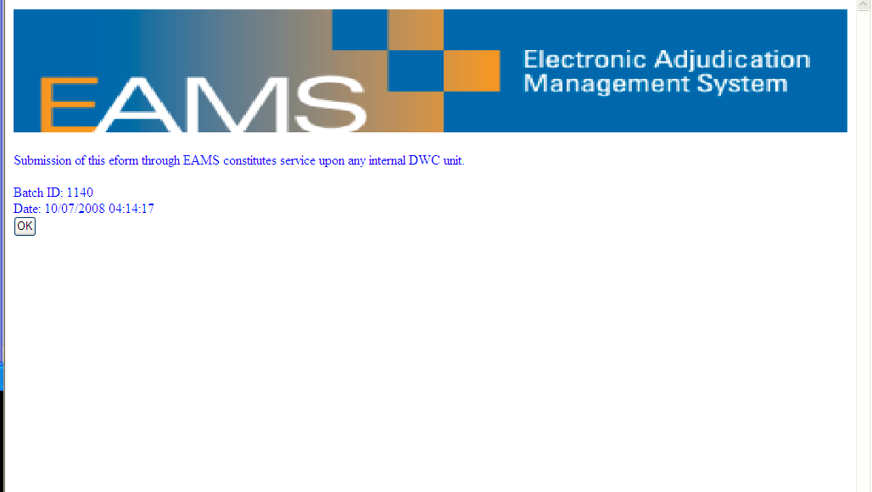
Batch ID
Save a screenshot to your computer (Alt + PrtScn) and print a hard copy as well, because the Batch ID reference number is very important when submitting requests for information, especially if the batch ends up in the UDQ.

Slide 115
Batch ID cont.
Per the Reference Guide (page 14):
  “Remember, you are only submitting your batch. It is not considered ‘filed’ until it has been processed, but your submission date is your ‘filing date,’ except for submissions sent after 5:00 p.m., Saturdays or Holidays when the filing date will be the next business day. Log out of EAMS.”

Slide 116
FileNet
Notes:
116

Slide 117
View Your Documents in FileNet
There are 2 ways to access FileNet
  Option 1.
    Open the ADJ Home Page
    Click on “Filenet Document” link in the upper right corner
  Option 2.
    Click on “Related Cases” tab in the upper right – this opens the INT Home Page
    Click on the case Integrate Case, then scroll down to the Case Documents Section – Click on the INITIALS – “ADJ” (If you click on the case number just below it, you will go back to the ADJ Home Page.)
    FileNet opens – follow the directions in the Reference Guide on how to best view the documents.

Slide 118
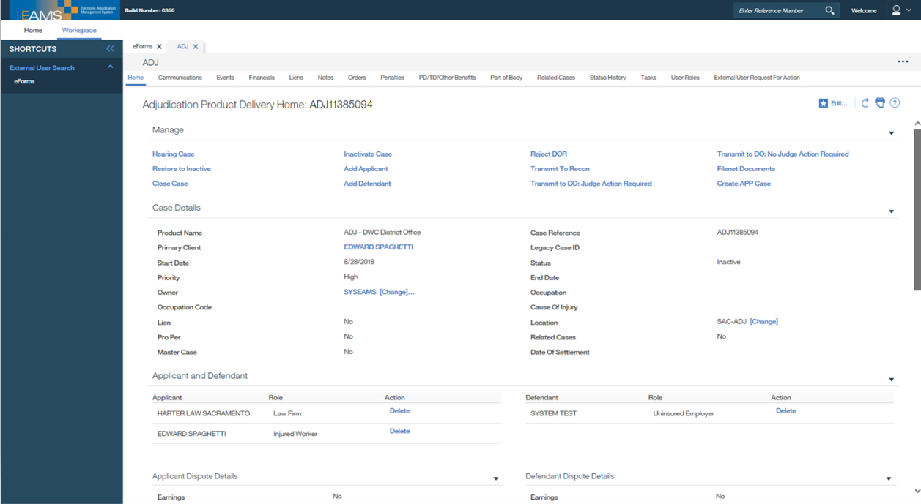
Accessing FileNet
Click on “Filenet Documents.”

Slide 119
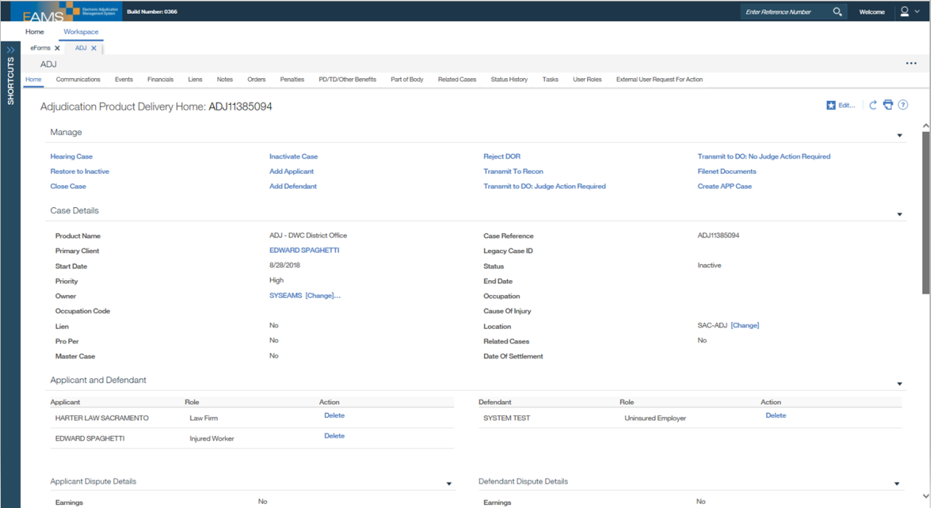
Accessing FileNet cont.
Click on the “Related Cases” tab.

Slide 120
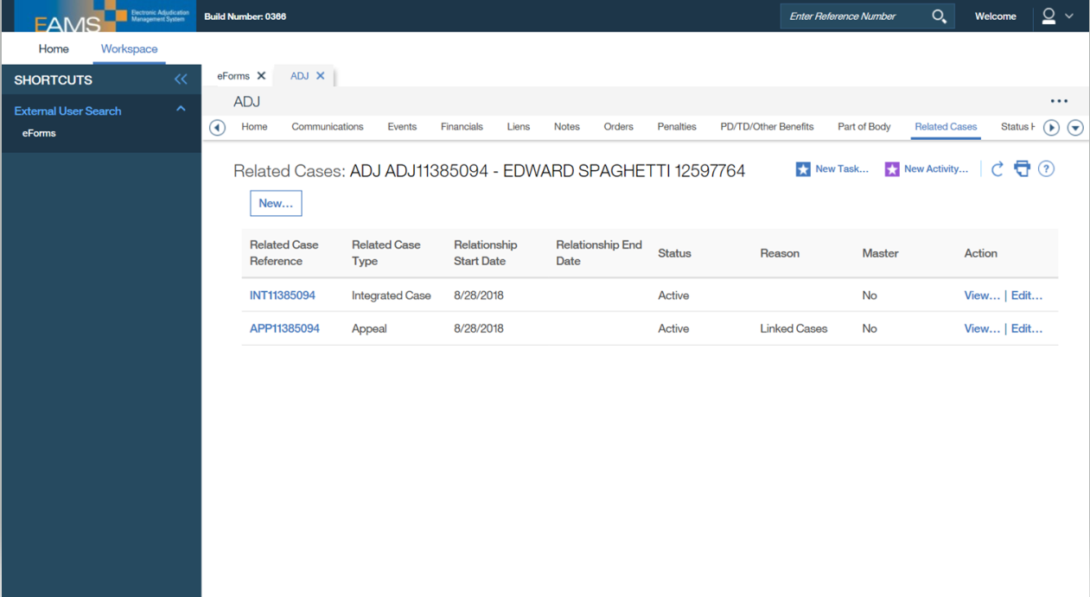
Accessing FileNet – INT Home Page
Click on “INT.”

Slide 121

Accessing FileNet - INT Home Page cont.
Click on “ADJ.”

Slide 122

FileNet Page
Example of a FileNet Case Document page (See page 68 of the Reference Guide for additional details)
Documents can be sorted by type, title, date, etc.
Click on a heading to sort documents by type, title, or date.

Slide 123
FileNet Page cont.
To open the document either double click on the Title to view in a new tab or window or right click on the Title to download the document.
Use the Search Criteria to find a specific document by author, title, or date.
Click on Search Criteria to look for a specific document.
Double click on the title to view or right click to download.

Slide 124
EAMS Help Desk
Notes:
124

Slide 125
Contacting the EAMS Help Desk
E-filers* contact EAMS Help Desk when you have question(s)/problem(s)
Preferred method of contact is:
  1) Send an e-mail to EAMSHELPDESK@dir.ca.gov
  2) Call the Call Center at 1-888-771-3267
  Hours: 8 a.m. to 5 p.m. – Monday through Friday (except holidays)
  e-mails after 5 p.m. may be handled the next business day
*NOTE: Only the Primary Administrator may contact the EAMSHelpDesk

Slide 126
Problem Solving Chain of Command
The Primary Administrator contacts EAMSHELPDESK@dir.ca.gov and/or EFORMS@dir.ca.gov for assistance
  Remember to include your Batch ID #, case #, IW’s name, and type of eForm submitted, screenshots, when appropriate, and your contact information including your UAN and ERN.
  If this is a UDQ related issue add “UDQ Supervisor” to the subject line, otherwise they will not have access to this email.
EAMS experts will review the issue and determine if the issue is due to a system or user error.
The Primary Administrator will be contacted as information becomes available and advised what steps to take to resolve the issue and to prevent reoccurrence if possible.

Slide 127
Helpful Hints
Take screenshots of error messages
  How? ALT + Print Screen then save into a Word document and attach to your e-mail for EAMS Help Desk to view and possibly submit to issue tracker.
15 minutes of inactivity on EAMS will time you out
30 minutes of inactivity on an eForm will time you out and you will have to start the eForm again
If you entered your password incorrectly too many times, clear your browser cache, reopen the window and wait 30 minutes before trying again.
  Remember, only the Primary Administrator should email EFORMS@dir.ca.gov to have their password reset.
  Make sure you type your password versus copying and pasting as this may add an extra space.

Slide 128
The UDQ
Notes:
128

Slide 129
What is the UDQ?
Unprocessed document queue (UDQ)
This is a repository within EAMS where forms with mistakes end up to be reprocessed or deleted, if the issue cannot be corrected.
Over 500 batches go to the UDQ each week, and each batch can have multiple attachments that require a thorough review to try and identify what caused it to fail.
We currently only have one (1) UDQ Operator who works with a small team of volunteers to review failed batches.
  There is a backlog that is being addressed, so please do not keep refiling until you get the result that you want, because it will just increase reprocessing times.

Slide 130
Duplicate Filing
If you don’t see the document in FileNet after the next batch run, WAIT, and check the next morning.
If it still is not there, have your Primary Administrator email the EAMS Help Desk (EAMSHELPDESK@dir.ca.gov)
  Be sure to include the IW name, DOB, Batch ID #, UAN, ERN, and EAMS case number if used.
  DO NOT REFILE
If the Primary Administrator is told it is in the UDQ, DO NOT REFILE
  UDQ Operator may have to:
    Un-archive a case
    May be able to fix the problem and reprocess
    Will email you with the errors if the batch had to be deleted

Slide 131
Duplicate Filing cont.
If the Primary Administrator is informed by the EAMS Help Desk that the batch is not in the UDQ and it is still not in FileNet, their next step is to:
  Email the UDQ supervisor at EFORMS@dir.ca.gov
    Put UDQ SUPERVISOR in the subject line to get assistance and remember include the batch ID in the body of the e-mail
    Include your UAN, the Batch ID, IW Name and DOB, the type of document, the EAMS case number from the Document Coversheet you filed (incorrect case number may have been entered).
  The supervisor will e-mail you with further instructions
  DO NOT REFILE unless the e-mail says the batch was deleted

Slide 132
Duplicate Filing – User Error
If right after you click “Submit” you realized you made a mistake:
  Have the Primary Administrator email the UDQ supervisor with the:
    IW Name
    Batch ID
    Case Number
    Document type
    DO NOT REFILE
  If the Batch processed successfully, the documents may need to be deleted.
Either way, DO NOT REFILE – wait for an e-mail.

Slide 133
Staying out of the UDQ
Review your case in EAMS to get all information needed to file your document BEFORE you file it – check for correct spellings, addresses and dates.
If you are a case participant and cannot see your case in EAMS, e-mail the EAMS Help Desk before you file your document.
Please use the EAMS case number, not the legacy case number on your documents. Use the case number lookup tool on the DIR website.

Slide 134
Staying out of the UDQ cont.
Do not check a box/radio button unless you mean it, because you cannot uncheck it, which will force to you exit and start from the beginning.
Leave fields blank where they do not apply: If there is no applicant or defense attorney, leave the fields blank. Do NOT type N/A, NONE, IN PRO PER or anything else in the field.

Slide 135
Staying out of the UDQ – Case Opening
If filing a case opening document, such as an Application for Adjudication, Compromise & Release, or Stipulation with Request for Award, do NOT type "unassigned" in the case number field, instead leave this field blank. When filing a new or amended Application for Adjudication, Answer to Application for Adjudication, or Liens do NOT include companion case numbers on the Cover Sheet, even if they exist.

Slide 136
Staying out of the UDQ – Amended Application
When filing an Amended Application for Adjudication: make sure the amended box is checked!
You must enter the Date of Injury (DOI) on the Document Coversheet – failure to do so results in a default DOI being assigned. Even if you have a case number the DOI should still be included (See page 48 of the Reference Guide).

Slide 137
Staying out of the UDQ – Amended Application cont.
Please identify what is being amended in paragraph 2 on Form 4 or as an addendum: DOI, DOB, Name, Body Parts, etc.
  For example: “Amending DOI to 01/01/2010”
  Be very clear about what needs to be altered, because these changes are made manually.
If you change the claims administrator, enter the new one in that section on the eForm, noting the change in paragraph 2 on Form 4 or as an addendum.

Slide 138
Staying out of the UDQ: Use of the UAN
Make sure you correctly enter your own Uniform Assigned Name (UAN), as well as any others that you may reference.
Make sure the UAN — NOT the claims adjuster’s name—is in the Claims Administrator name field. Unless the employer is uninsured, this field must always have an UAN.
If the employer is self-insured, DO NOT put a name and address in the Insurance Company fields – they are not assigned the role of an insurance company.
For Claims Administrators and Lien Claimants that file applications: You are the “applicant” in this instance; if there is an attorney representing the defendant or lien claimant, their UAN goes in the Applicant Attorney field.

Slide 139
Staying out of the UDQ: Document Titles
Use the proper document title for attachments:
  The drop down list contains DWC external user titles only.
  You will need to refer to the external Document titles list that you can find on the E-form filers webpage. Please note that document titles determine if a task is set for review, so using the correct document title is important. Make sure to choose the right one for your attachment(s).
What if there is no document title for your attachment?
  Does the document require immediate review and action by a Judge?
    If no, it will be filed under ADJ – MISC - CORRESPONDENCE – OTHER
    If yes, the document is filed ADJ – MISC - TYPED OR WRITTEN LETTER
      It is very rare to use ADJ – MISC - TYPED OR WRITTEN LETTER as your document title, because it creates a task. Please do not use this option unless otherwise instructed.

Slide 140
Staying out of the UDQ: Document Titles cont.
Examples:
  A QME Notice – yes, it is a letter, but does not need to go to the immediate attention of the judge?
    Use ADJ – MISC – CORRESPONDENCE-OTHER
  Cross-examination of Rater (See page 25 of the Reference Guide)
  File DOR requesting Conference:
    Use ADJ – MISC – CORRESPONDENCE-OTHER
  Attach document requesting case be set for testimony:
    Use ADJ – MISC – TYPED OR WRITTEN LETTER
    Remember, it is extremely rare that you would use TYPED OR WRITTEN LETTER.

Slide 141
Staying out of the UDQ: LIEN FILING
ALL LIENS MUST BE FILED AS ORIGINAL – Enter the date you prepared the lien in the field “DATE OF ORIGINAL LIEN” – this is the same date that is entered on the Document Cover Sheet.
No amended liens can be filed with the Workers’ Compensation Appeals Board (WCAB)!
Proof of service, verification, and other attachments are attached separately.
If something on your lien has changed, do not file an amended lien with the WCAB; however, you must serve the other parties with the amended lien.
  To Withdraw a lien, the Document title from the drop down list is:
  ADJ – LIENS AND BILLS – REQUEST FOR WITHDRAWAL OF LIEN

Slide 142

Lien Payment
Example of the Lien payment screen.

Slide 143
Staying out of the UDQ: Other Tips
Please DO NOT file cover letters; they are not needed.
DO NOT file copies of prior Minutes of Hearing (MOH), Awards, or Orders; they are already in the District Office file.
If an eForm was filed and the attachments or Proof of Service were not filed, DO NOT file the same eForm again; just file the attachments/proof of service using the unstructured eForm.
BEFORE going to the District Office for a walk-through you MUST verify that the documents are in FileNet.

Slide 144
Staying out of the UDQ: Other Tips cont.
When entering EAMS case numbers on the Cover Sheet, the DOI field can be blank, and make sure that none of the boxes are checked for specific or cumulative trauma; this also applies to companion cases; but, double check that the case numbers are correct and that they belong to the correct injured worker.
Please be sure to enter your UAN on the Notice of Representation or Substitution of Attorney; e.g. “Please enter our appearance for XXXXXXXX. Our UAN is XXXXXXX.”
If you are filing a Dismissal of Attorney with a Substitution of Attorney, scan them together as a single multi-page document. The document title will be ADJ – Legal Docs – Substitution of Attorney.

Slide 145
Reprocessed Batch
After the next batch run, check to see if the document(s) are in FileNet.
  If not, DO NOT REFILE
  Email EFORMS@dir.ca.gov and include “UDQ Supervisor” in the Subject line to follow-up on the status of your batch. Include the original email text, so that this information can be quickly located.

Slide 146
Additional Tips & Tricks
Notes:
146

Slide 147
Filling out eForms by Copy and Paste
Copy text blocks from your report and paste them into your eForm.
  Please note: sometimes when you use copy and paste a space may get added at the beginning or end of a name, number or address.
  All extra spaces need to be removed as our system reads spaces as a character, which will cause your batch to go to the UDQ.
Trick for right-hand keyboard users: Use <CTRL>c to copy, <CTRL>v to paste
Trick for left-hand keyboard users: Use <CTRL><Insert> to copy, <SHIFT><Insert> to paste

Slide 148
Copy and Paste your Batch ID Info
Highlight your Batch ID number, date and time
To copy:
  Right-hand keyboard users: Use <CTRL>c to copy, <CTRL>v to paste
  Left-hand keyboard users: Use <CTRL><Insert> to copy, <SHIFT><Insert> to paste
Open your Batch ID spreadsheet
  Yes, it is helpful to keep a running log of all batches filed, because this information may not be accessible if the batch ends up in the UDQ.
Paste this information into the proper field
You can add the IW name, case number, and the type of document filed
This provides a central list of the batches submitted

Slide 149
Some common errors in EAMS
“You do not have sufficient privileges to view this page”
  You are limited in what you can view in EAMS. Just hit the back button or link.
“No Suitable Slot Could be Determined”
  This is a conflict in the electronic court calendar in EAMS.
  E-mail EAMSHELPDESK@dir.ca.gov to inform us that the “no suitable slot” error populated when e-filing. Include the ADJ number and any companion case ADJ numbers that should be scheduled for hearing. The eForms team will research and clear the error, so you can e-file your DOR.
“Case is Archived”
  Please e-mail EFORMS@dir.ca.gov with the ADJ number(s) so that we can retrieve it for you. Retrieval requires a minimum of 2 hours to complete.

Slide 150
Preparation Tips and Tricks
ORDER: Gather all pertinent info AHEAD OF TIME.
  EAMS case numbers
  Uniform assigned names
  Addresses for parties
  Body parts, etc.
PREPARE, SIGN, and SCAN all documents to be submitted with your eForm ahead of time.
  Please make sure that they are titled correctly.
Avoid getting LOGGED OUT – Fill out your eForm(s) without interruptions to avoid being logged out from EAMS/eForms.
PRINT your eForm before submitting and serve on parties.

Slide 151
Final Reminders
Take advantage of available tools and resources!
  EAMS website
  EAMS Help Desk (EAMSHELPDESK@dir.ca.gov)
The Primary Administrator is responsible for:
  Managing the login and password
  Training
  Problem solving
  Contacting the EAMS Help Desk
Provide feedback!
  Report problems
  Report useful tips

Slide 152
Final Reminders cont.
E-filing allows for:
  Accurate, faster submission time for you
  Faster document processing at the District Office
  Immediate submission status check
  Overall efficiency and timely results
  AND IT’S EASIER!

Slide 153

eForm Filer Partnership
It takes patience and teamwork to be a successful e-filer.
eForm participants are essential to helping DWC locate and address bugs in EAMS.
EAMS is a work in progress and please know that your input is valued and appreciated.

Slide 154
Ask the Experts
Starting in December 2022, the DWC-EAMS Unit will hold a two-hour open house each month for select Primary Administrators to allow them the opportunity to drop-in and meet with EAMS experts to ask e-filing questions.
These sessions will be by invite only and will be scheduled on a rotating basis, so that everyone gets the chance to attend. Please do not submit a request to attend a specific meeting as these will be preassigned.
A “Frequently Asked Questions” (FAQ) guide will be included with the invite, so be sure to review this ahead of time as it may include the answer to one or more of your questions.

Slide 155
Time for a quiz
Congratulations you finished the eForms training presentation.
In order to complete your registration you must take a quiz to demonstrate your understanding of how to e-file in EAMS.
Send a request for a quiz to EFORMS@dir.ca.gov and be sure to include your UAN, ERN, and “eForms Quiz” in the Subject line.
You must receive a score of 15 or higher out of 20 (75%) to be considered as passing. If you do not meet this minimum score you will be asked to wait a week, during which time you should review the presentation again, and then send in a request for another quiz.
Upon the successful completion of the quiz, your user login and password will be provided within approximately 48 hours from the following business day.

Slide 156
The End
Notes:
156

