Slide 1
Online Wage Claim (OWC) Form
Labor Commissioner’s Office
Wage Claim Adjudication (WCA) Unit
Community User

Slide 2
Table of Contents (OWC Community User)
Link to OWC on Website
Create Community Account/Login
Community Dashboard
Filing:
As Claimant
As Representative/Advocate
Certification
Industry
Employer
Work Locations
Employment Status
Filing: (Cont.)
Payment of Wages
Workday & Workweek
Hours Typically Worked
Issues Claimed
Submitting the Claim
Notifications/Reminders
PDF Summary

Slide 3
Online Wage Claim Web Link
https://www.dir.ca.gov/dlse/HowToFileWageClaim.htm
Works from computer, tablet, or phone. How a date is entered depends on the operating system.
You must have an email address to create a community user account.
If you forget your password, click the “Forgot your password?” link. (Screenshot on next slide).
At the bottom of each page is a link “For Support, contact the Labor Commissioner’s Office”. That link will take you to a list of Labor Commissioner’s offices as well as telephone numbers and email addresses.

Slide 4
Create a Community Account/Login

Slide 5
Create a New Community Account
Click on the slide and press play to see video.

Slide 6
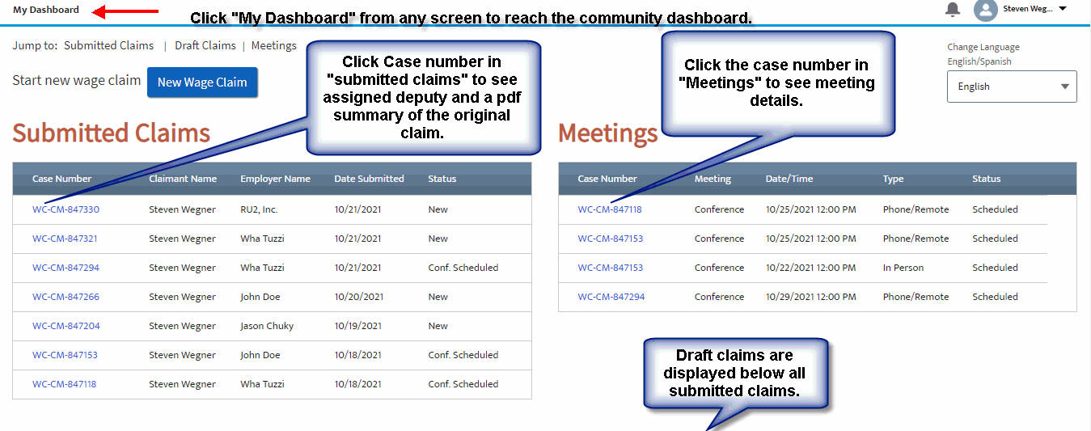
Community Dashboard
Notes:
Need to add dashboard

Slide 7
Starting a New Wage Claim
Notes:
Need to add dashboard

Slide 8
Draft Wage Claim
You can stop and save your claim as a draft at any time by clicking the button in the upper right of every page of the claim form.
Your draft will be stored under the submitted claims under a heading .
To resume work simply select the draft claim. The draft will have a system generated name as well as the date the draft was saved.
Once you finish and submit the draft claim, the draft will no longer appear and the claim will be under submitted claims.
If a draft claim is not submitted within 120 days of its being created, the draft claim will be deleted.
Notes:
Need to add dashboard

Slide 9
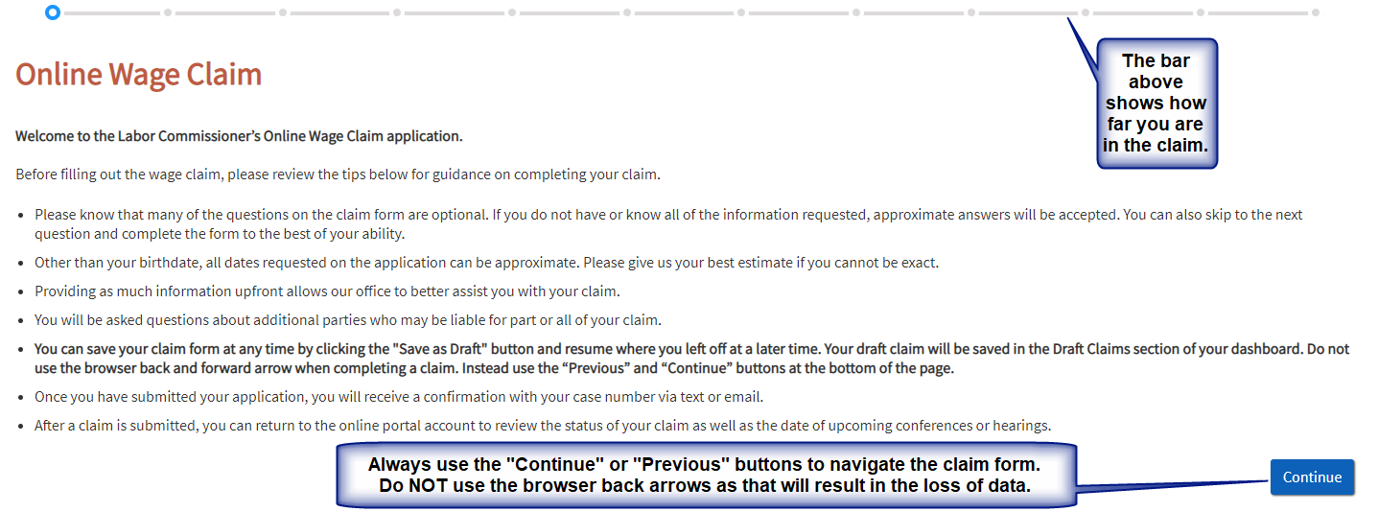
Initial Screen when Filing a New Claim

Slide 10
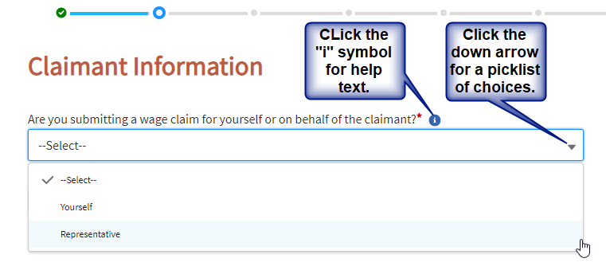
Claimant Information
All fields marked with a red asterisk are required fields.
You can either file as the claimant or as an advocate/ representative.
The next questions asked will depend on how you answer.
Select “Yourself” if you are the claimant.
Select “Representative” if you are the advocate, representative, attorney, friend or someone filing on behalf of the claimant.
Filing as a representative means the claimant will have to authorize the claim within 60 days of submitting the claim or the claim will be closed.

Slide 11
Filing as Claimant
If you selected “Yourself” from the previous screen then you will be asked for information regarding the claimant.
Required fields are “First Name”, “Last Name”, “Birth Date” (to prevent duplicates and match accounts), and “Zip Code” (to help assign the correct office).
If an email and/or cell phone is entered then claimant will receive automatic updates regarding the filing and meetings. It also allows the assigned deputy to more quickly communicate with the claimant.
On that same screen you will have the option to request an interpreter for claimant and specify the language. You will also be asked if claimant has a representative or advocate who is assisting them.

Slide 12
Filing as a Representative
If you selected “Representative” then you will be asked for the “Representative Advocate Type” (Individual or Law Firm/Organization).
Required fields are “First Name”, “Last Name” and “Phone”.
If an email and/or cell phone is entered then the representative will receive automatic updates regarding meetings. It also allows the assigned deputy to more quickly communicate with the representative.
On that same screen you will be asked for information regarding the claimant as well as whether the claimant requires an interpreter and, if so, what language do they need.

Slide 13
Confirmation by the Claimant
When a claim is filed by someone other than the claimant, the Labor Commissioner’s Office will require confirmation from the claimant. An option to upload a confirmation form will appear immediately after the representative information.
Or the claimant will receive an email asking if they confirm or deny the claim. That email will only be sent if an email address was provided for the claimant. If no confirmation is received within 60 days of submitting the claim, the claim will be closed.

Slide 14
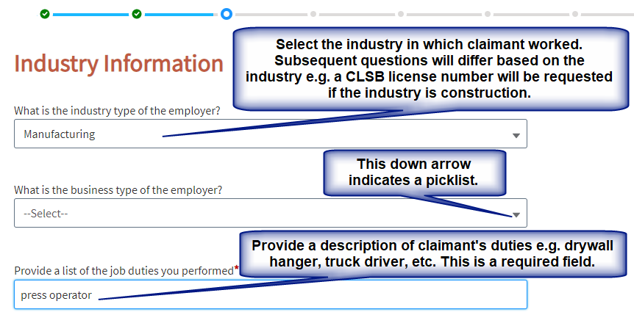
Industry Information

Slide 15
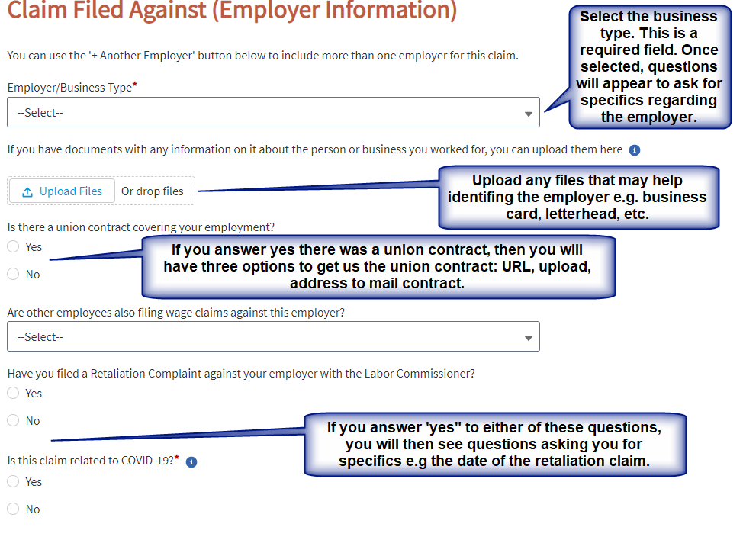
Claim Filed Against (Employer Information)

Slide 16
Employer Specifics
Once you have selected the business type for the employer, you will be presented with questions about the employer such as name, address, phone number, etc.
Please give us the employer’s email and/or cell number if you know them. That way we can contact them by email or text.
At the bottom of the page there is a button to add another employer. Before you get to that button you will have the option to add additional responsible parties who are not the employer.
If there is more than one responsible party there is a ---button to add additional responsible parties.

Slide 17
Additional Information
In this section you will be asked:
About additional people in charge or who may otherwise be responsible
Who paid claimant
Who set the work schedule
How were claimant’s work hours tracked
Signing time cards

Slide 18
Additional Information (continued)

Slide 19
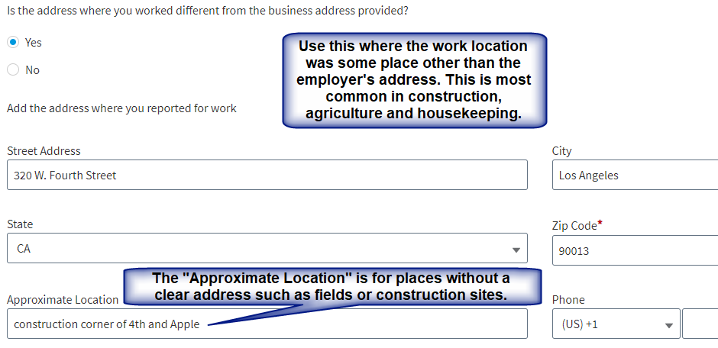
Other Work Location

Slide 20
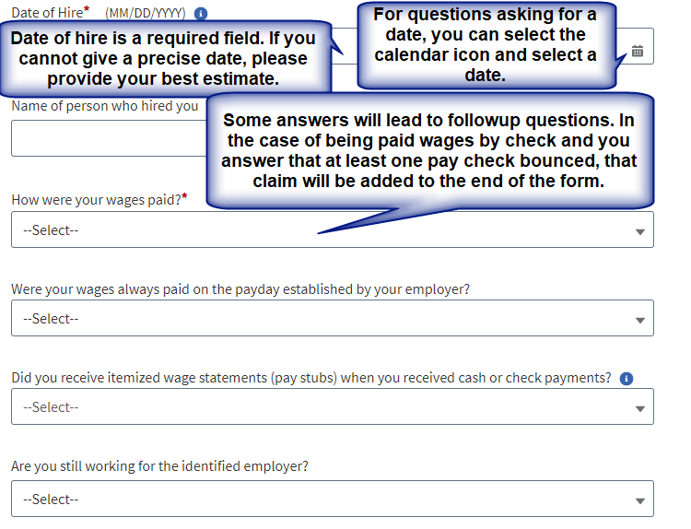
Employment Status and Final Wages

Slide 21
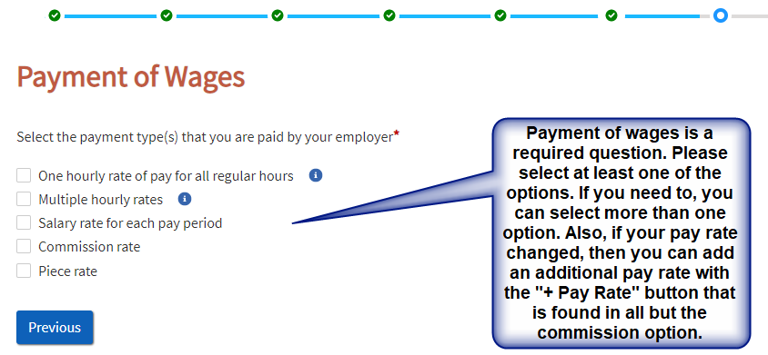
Payment of Wages

Slide 22
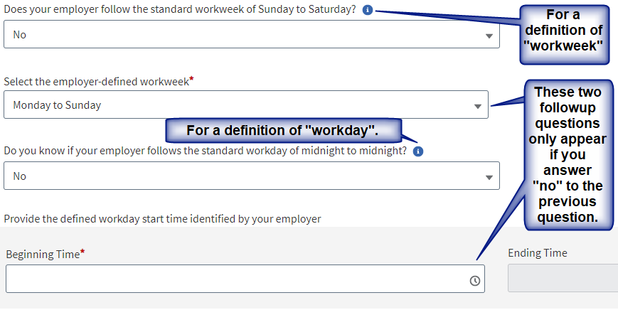
Workweek and Workday

Slide 23
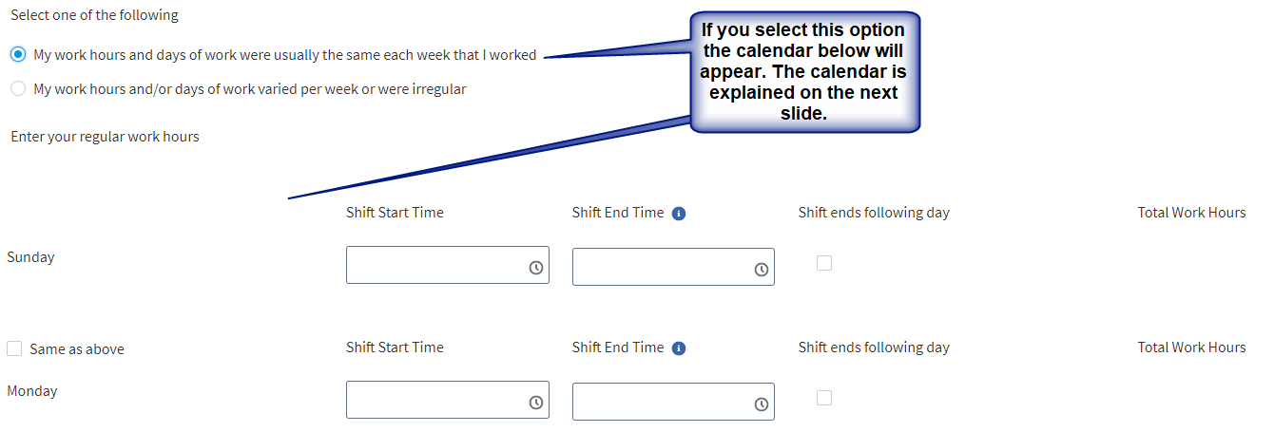
Hours You Typically Worked

Slide 24
Hours You Typically Worked (continued)
Time entries can be made from the drop down list or manually typed in. All times must show am or pm.
When you enter more than 5 hours, you will be asked about the first meal period. Entering 10 or more hours will also ask you about a second meal period. If you did not receive a meal period just leave those fields blank.
“Shift ends following day” is for shifts that cross midnight e.g. shift starts at 10 am Monday but ends at 6 am Tuesday.
If the next work day is the same, you can simply select the “Same as above” checkbox.
Your total work hours will be calculated for you. Meal periods are not work hours.

Slide 25
Hours You Typically Worked (continued)

Slide 26
Hours You Typically Worked (continued)
If your work schedule was irregular, then download the DLSE-55, complete it, then upload the completed form. The DLSE-55 is completed by pay period total so you do not have to enter each day unless you want to.
If you answer “yes” to whether there were any exceptions to your work schedule, then you will be asked for the total number of days and reason e.g. workers compensation, FMLA, etc.
Holidays you did NOT work is required. There is an option in case you worked all holidays.
If you select “Other holidays you did not work” then you will be given a text box where you can type in what those days were.
Holiday pay is only available if the employer agreed to pay for holidays. Normal wages are always due for days you worked.

Slide 27
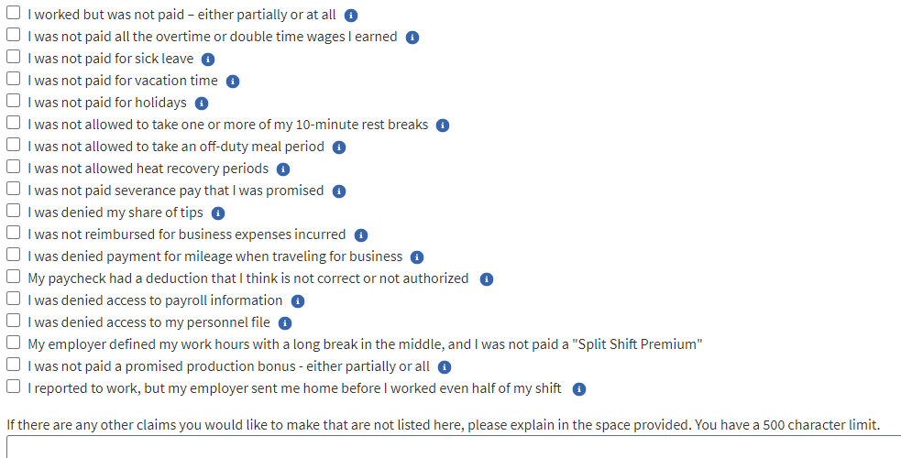
Wage Claims

Slide 28
Wage Claims
On the previous slide is a screenshot of the wage claims you will find at the end of the claim form. Some will automatically be started based on your previous responses. However, you can select any claim you may have.
At the end of each claim title is an icon. Clicking these icons will give you help text about the claim.
Most claims have a button which you can use to select a second claim of the same type e.g. If you have a wage claim at $15 an hour, then you would use the “+ claim” button to have a second claim, for instance, if you later received a raise or were paid a different amount.
Many claims allow just an amount claimed. However, the more information you give us, the better we can process the claim. If you are unsure, please give us your best estimate.
Some claims will have a drop down list to select the nature of the claim before giving you the fields to complete e.g. overtime and sick leave.
Some claims require a prior answer e.g. you cannot claim vacation unless you indicated you no longer work for the employer.

Slide 29
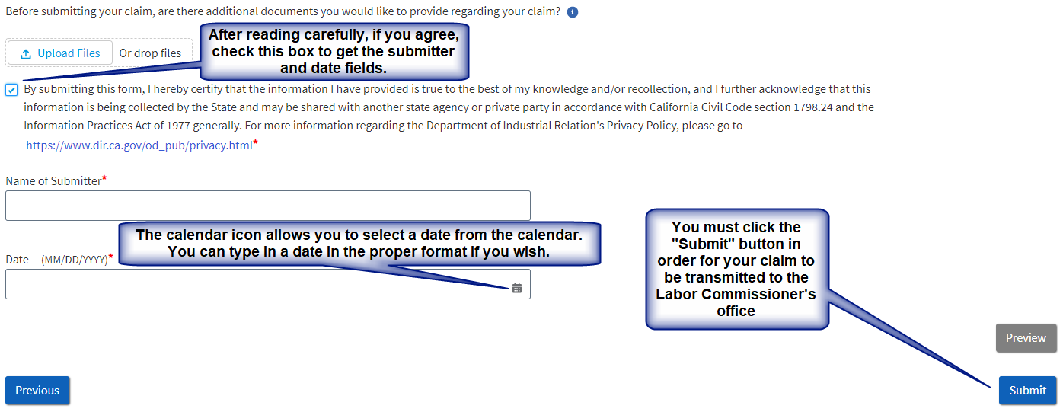
Certification and Authorization

Slide 30
Online Wage Claim (OWC) Form
Labor Commissioner’s Office
Wage Claim Adjudication (WCA) Unit
Community User (Public Facing Salesforce)
Thank You!

